Slide 1







TIMETABLE PLANNER WEBSITE
AC4150E
-
152296
Final
Report
From:
Group 3

Slide 2




Table of Contents!
Design Evolution
Project Introduction
Final Prototype Implementation
Needfinding
Reflection and
Next Steps
Also Included:
Appendix
Concept Video

Slide 3

01
Project Introduction

Slide 4
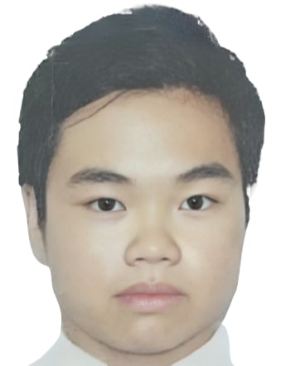



Nguyen Gia Bao
Nguyen Do Hoang Minh
Nguyen Huu Phong
20210099
ET-E16 – K66
UI Designer
20210591
ET-E16 – K66
Web Developer
20210668
ET-E16 – K66
Team Leader

Slide 5




Name, Logo and Slogan
Value Proposition
Name: PlanMate.
Logo: A pen drawing/writing timetable with initial letters of the app.
Slogan: “Your best mate in college”.
-> Fun, short and easy to remember.
-> Highlight support and companionship for students.
Effortless timetable planning tailored for HUST students.

Slide 6

Name, Logo and Slogan
Value Proposition
Name: PlanMate.
Logo: A pen drawing/writing timetable with initial letters of the app.
Slogan: “Your best mate in college”.
-> Fun, short and easy to remember.
-> Highlight support and companionship for students.
Effortless timetable planning tailored for HUST students.

Slide 7




Problem
Solution
HUST students face difficulties visualizing their timetables before course registration due to the lack of an official tool.
A user-friendly app that allows students to customize and visualize their timetables quickly, ensuring smooth course registration.
Primary Users
HUST students.

Slide 8
02
Needfinding

Slide 9


Target Participants
Current HUST students.
Students from other schools/universities.
User Groups
Normal Users (3): Basic tools/methods for scheduling.
Expert Users (1): Advanced knowledge of the systems.
Extreme Users (1): Unique/advanced scheduling behaviors.
Interview Method
HUST students: Offline interviews, face-to-face at school (5-10, max 20 mins).
Other students: Online interviews (Zoom, Messenger, etc.) (5-10, max 20 mins).

Slide 10

Questions
“How do you usually arrange your timetable? (Do you use any tools, like Excel, paper and pen, or websites?)”
Tools/Methods
“Are there any concerns you have when using these tools?”
User Experience
“How do you feel when arranging your schedule for a new semester? Do you feel stressed when selecting courses or organizing them?”
Feelings and Emotions
“Have you ever needed to share your timetable with friends or professors? If so, do you think sharing your schedule would be a useful feature?”
Difficulties and Solutions
“What do you think of the interface of the current system? Do you wish it would change in any way?”
Customizability and Features

Slide 11






Participants
Minh*
Expert User
Tai, Rose, Son, NMinh
Normal Users
Linh*
Extreme User
*: pseudonym

Slide 12
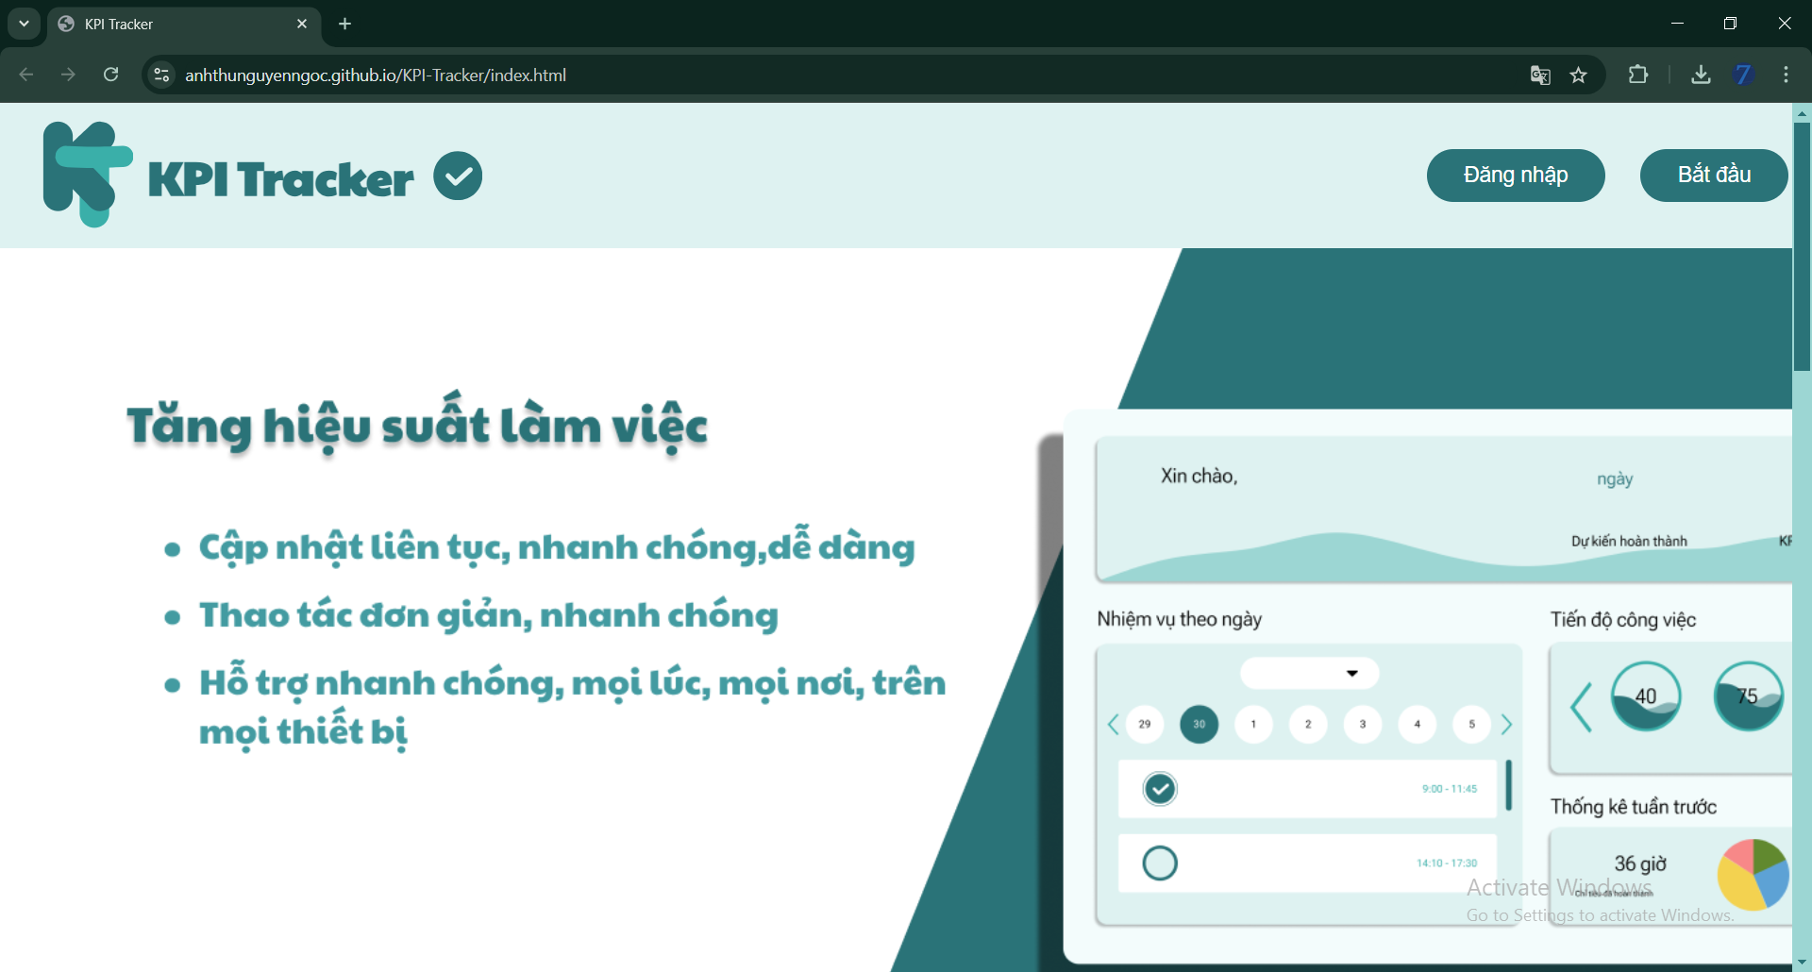
"Registering for classes is always a tough competition."
"Organizing a timetable online is really essential because it's more convenient than traditional methods."
Minh* (20)
"Different sessions of the same class are shown as if they are different classes."
4th year student from SOICT, HUST
Expert User (has experience in planner web development)
Offline Interview
"Both front-end and back-end optimizations are important."

Slide 13
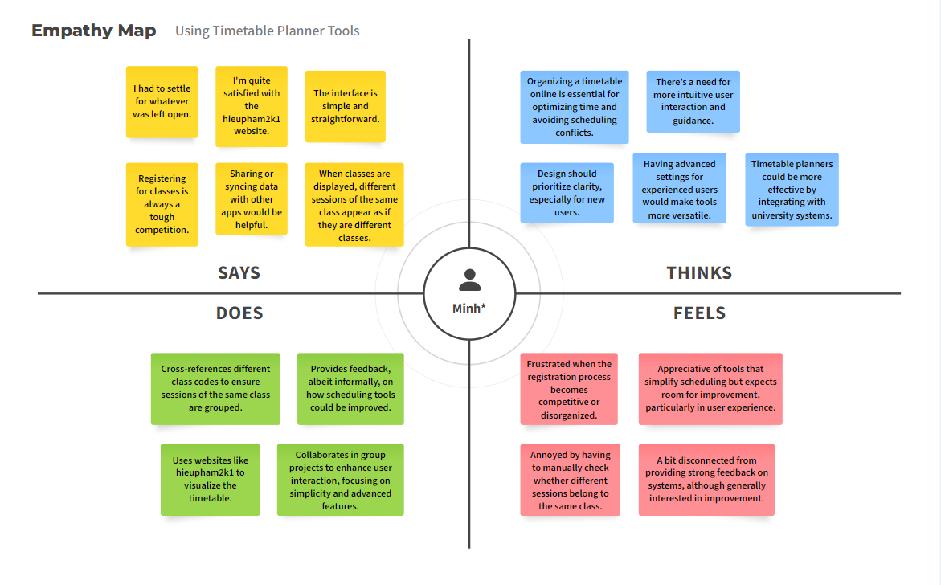
Minh*

Slide 14
Needs
Insights
Efficient Scheduling: Quick, clear course management.
Data Integration: Sync with university systems to avoid conflicts.
Simple Interface: Easy to use, with advanced options for experts.
Customization: Instructor filters, sync with external apps.
Automation is Key: Syncing saves time and reduces errors.
Visual Clarity: Unified views prevent confusion.
Balance: Users want simplicity with flexible, advanced features.

Slide 15
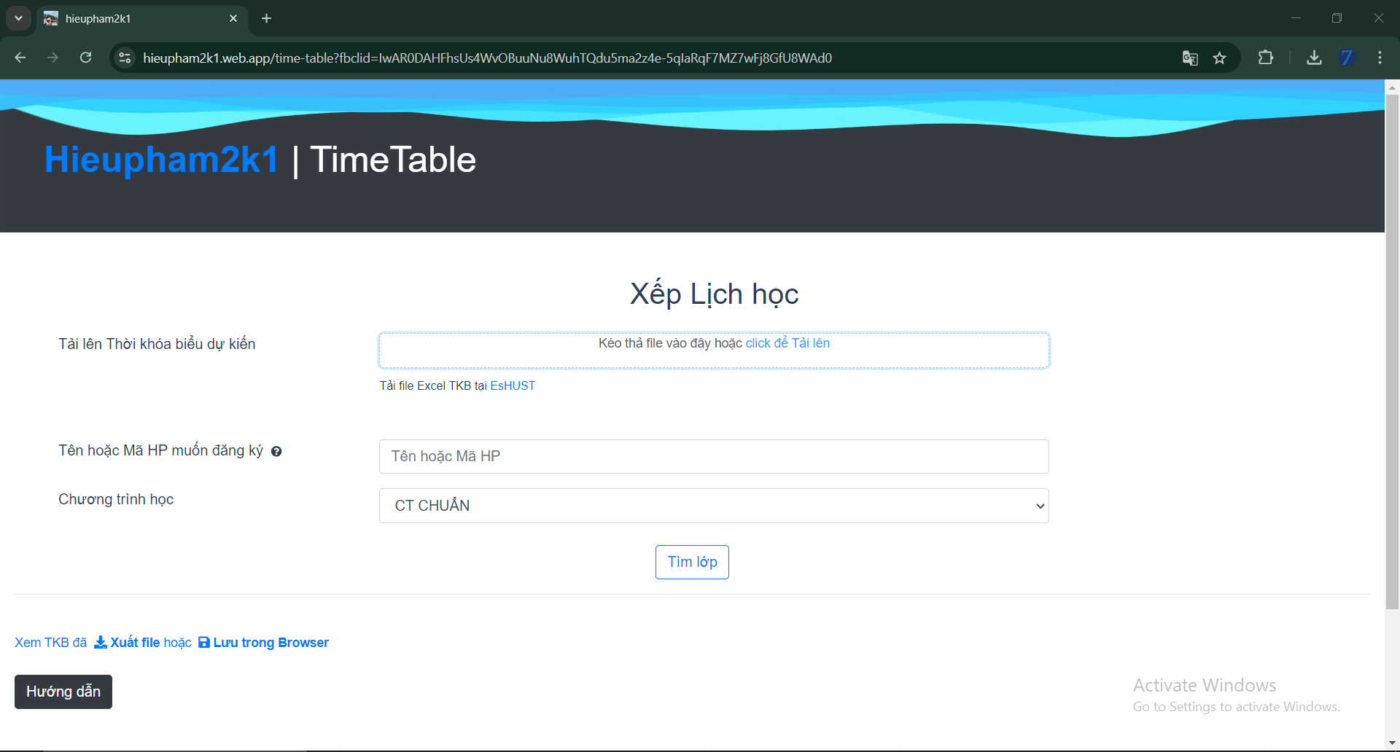
"I find online tools for scheduling timetables very useful... They save me a lot of time compared to traditional methods."
"I don’t usually feel stressed when setting up my timetable for a new semester."
Tai (20)
"Yes, I’ve already introduced the website to some friends for course registration."
3rd year student from SEEE, HUST
Normal User (has experience in using planner website)
Offline Interview
"I think everyone’s schedule is private and personal."

Slide 16
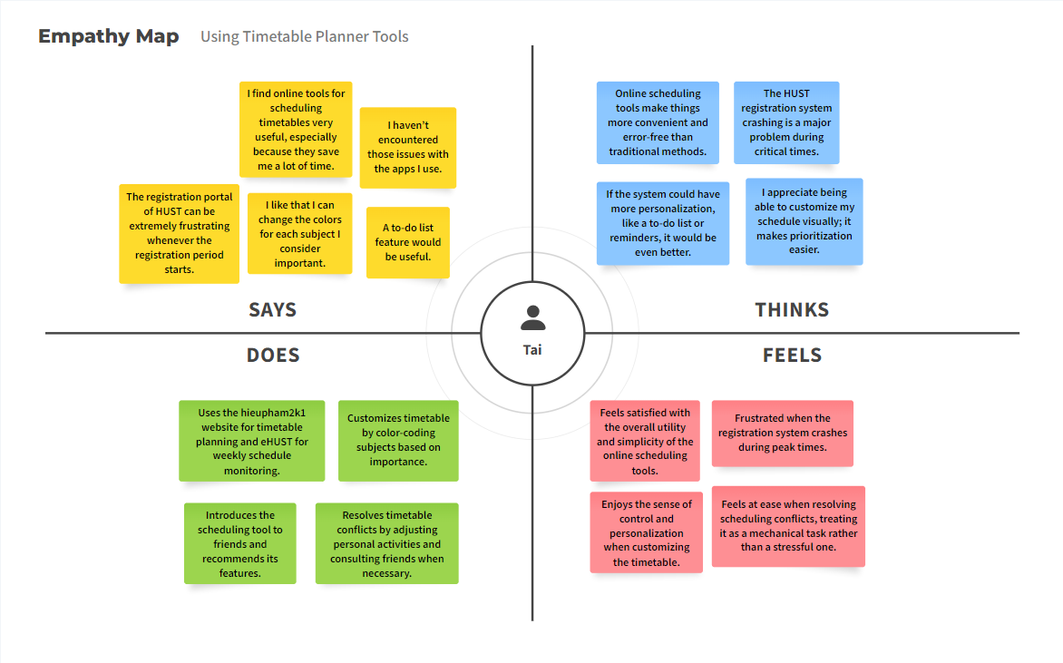
Tai

Slide 17
Needs
Insights
Stability: Reliable, crash-free system, especially during registration.
Customization: Personalize with colors and reminders.
Efficient Organization: Easy, clear scheduling without overlaps.
Simple Interface: Intuitive and easy to use, with helpful features.
Convenience: Online tools save time and effort.
Reliability: Stable performance is critical during registration.
Personalization: Custom options enhance control and satisfaction.
Low Stress: Users prefer simple, efficient tools, with extras as bonuses.

Slide 18
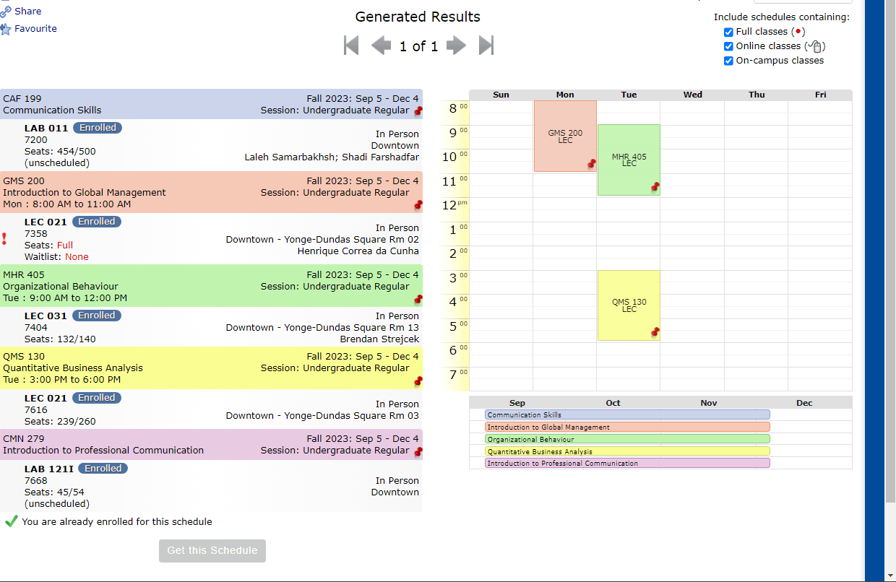

"I would definitely tell anyone that it’s a solid tool if they were to ask."
"Every enrollment period feels like a battle... there’s a lot of pressure to make sure you get into the classes you need."
Rose (21)
"The scheduling tool automatically prevents you from enrolling in classes that overlap."
Student from Toronto Metropolitan University in Ontario, Canada
Normal User (has experience in using Notes on iPhone + Visual Schedule Builder)
Online Interview
"It’s useful when I need to send my schedule to my job... having a built-in feature to share would be really helpful."

Slide 19
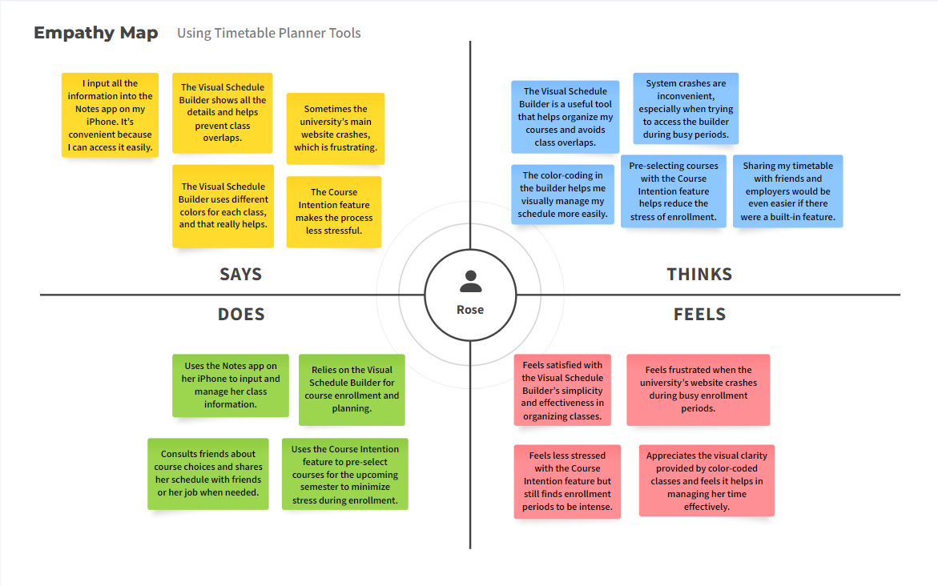
Rose

Slide 20
Needs
Insights
Reliability: Stable site during enrollment.
Customization: Simple tools with color-coding and clear layout.
Stress Relief: Pre-select courses to reduce anxiety.
Sharing: Easy schedule sharing for planning.
Simplicity: Straightforward tools prevent conflicts.
Efficiency: Crashes during peak times cause frustration.
Visual Clarity: Color-coding boosts usability.
Sharing: Customizable sharing options needed.

Slide 21
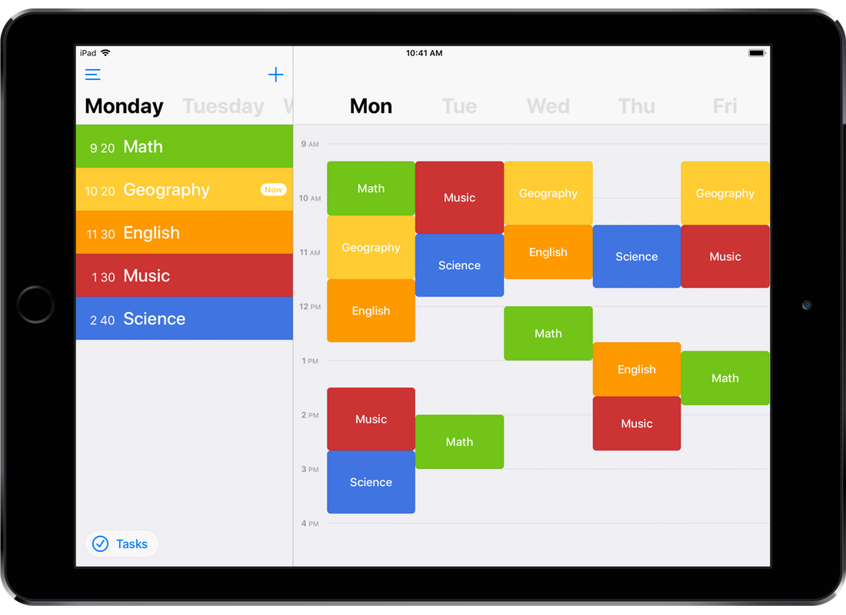

"Online tools are really useful... they simplify the process of organizing everything in one place."
"Organizing my schedule isn’t really a stressful process."
Son (21)
"I really appreciate the app’s speed and the overall smooth experience."
4th year student from HNUE
Normal User (has experience in using planner app)
Online Interview
"I’m satisfied with the current interface... but I’d probably want more customization options."

Slide 22
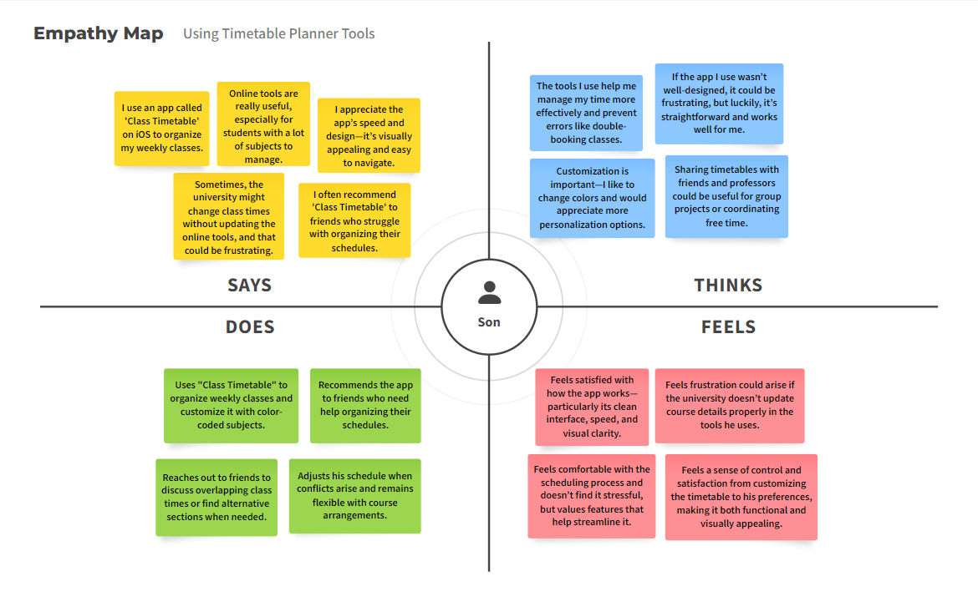
Son

Slide 23
Needs
Insights
Reliable Updates: Timely info on class changes.
Customization: Personalize timetables (colors, layouts).
Sharing Tools: Easy sharing with peers and professors.
Error Prevention: Avoid scheduling conflicts, flexible adjustments.
User-Friendly: Simple, fast tools ease organization.
Engagement Through Customization: Color-coding aids usability; more options would boost engagement.
Critical Consistency: Reliable university info is essential.
Future Sharing Needs: Easy sharing features benefit group coordination.

Slide 24

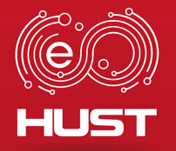

"I find it pretty easy... the website has made the process straightforward and quick."
"The university’s official system... has quite a few issues with the layout."
NMinh (21)
"I don’t usually have any issues with scheduling, thanks to the website I use."
4th year student from SEEE, HUST
Normal User (has experience in using planner website + apps)
Online Interview
"I don’t feel the need to customize my timetable."

Slide 25
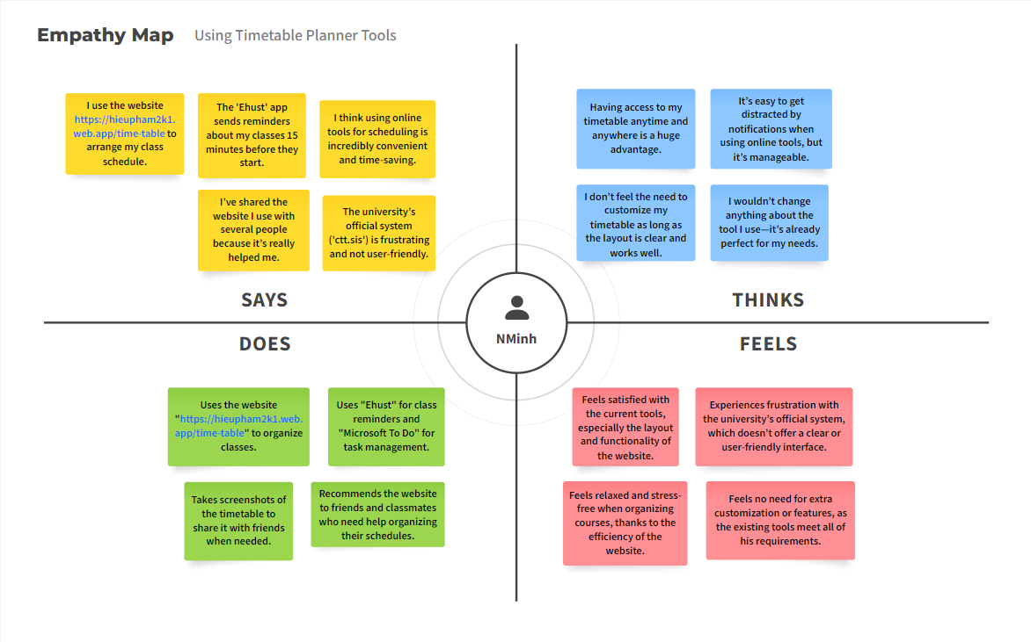
NMinh

Slide 26
Needs
Insights
Easy Access: Simple, clear, and mobile-friendly tools.
Timely Reminders: Notifications to track schedules.
Conflict Prevention: Tools to avoid overlaps and show complete schedules.
Sharing Options: Easy sharing features for collaboration.
Prefer Simplicity: Functionality over customization.
Convenient Access: Mobile access reduces stress.
Frustration with University Tools: Third-party apps are often better.
Collaboration Needs: Sharing features are beneficial for group work.

Slide 27
"I haven’t come across any specific applications yet, so I don’t have any personal impressions about them."
"The thought of automating that process sounds incredibly appealing."
"I worry that it might be more complicated than I expect and that I might encounter a learning curve."
Linh* (18)
1st year student from RMIT, Hanoi
Extreme User (manually plans timetable with helps from Notes on iPhone)
Offline Interview
"I’m drawn to visually appealing designs... a cute and attractive interface would motivate me."

Slide 28
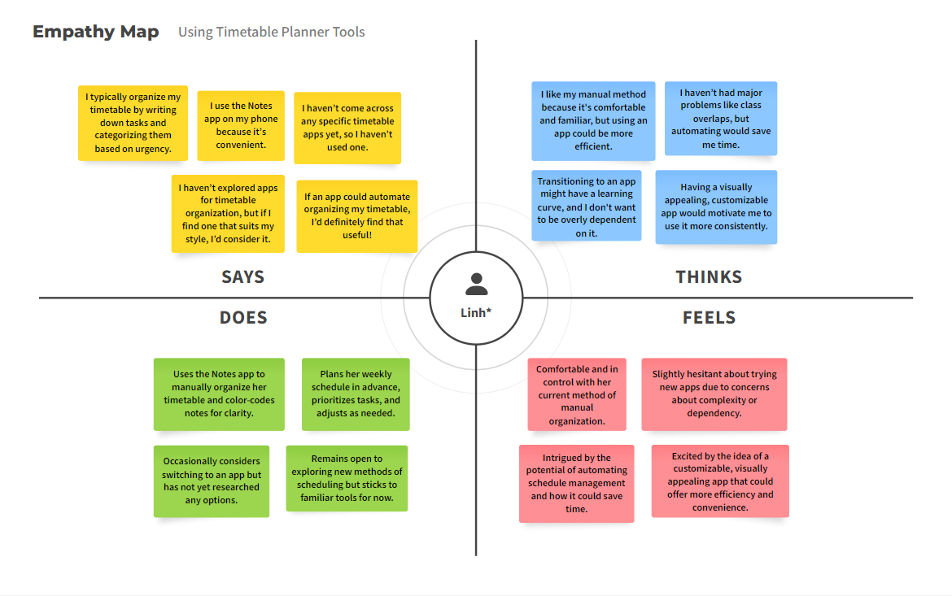
Linh*

Slide 29
Needs
Insights
Familiar Tool: Wants an intuitive app that feels familiar.
Automated Efficiency: Seeks automation while keeping control.
Customizable Options: Values personalization for engagement.
Control Assurance: Prefers to avoid dependency on technology.
Open to Digital: Will switch if it suits habits.
Customization Matters: Needs visual appeal to stay engaged.
Efficiency with Control: Wants to save time but maintain oversight.
Skeptical but Open: Interested in free apps with clear benefits.

Slide 30

Tensions and Contradictions
Simplicity vs. Customization
Technological Hesitance vs. Digital Acceptance
Reliability vs. Flexibility
Need for straightforward tools vs. desire for personalization;
extremes feel overwhelmed, normals feel restricted.
Demand for reliable systems during peak times vs. need
for flexible schedule management; crashes cause frustration.
Extreme users are skeptical; normals and experts embrace
technology.

Slide 31
Surprises
Simplicity vs. Customization
Normals prefer third-party tools,
highlighting gaps in university
offerings.
Importance of Visual Design
Visual appeal boosts usability and
engagement more than expected.

Slide 32
Summary
Common Needs
Development Insight
Users want simplicity, reliability, and collaboration.
Address diverse user preferences while tackling shared challenges in scheduling.
Key Tensions
Balancing simplicity with customization and ensuring reliability without sacrificing flexibility.
Please remember before going to the next step! ☺

Slide 33
03
Concept Video

Slide 34
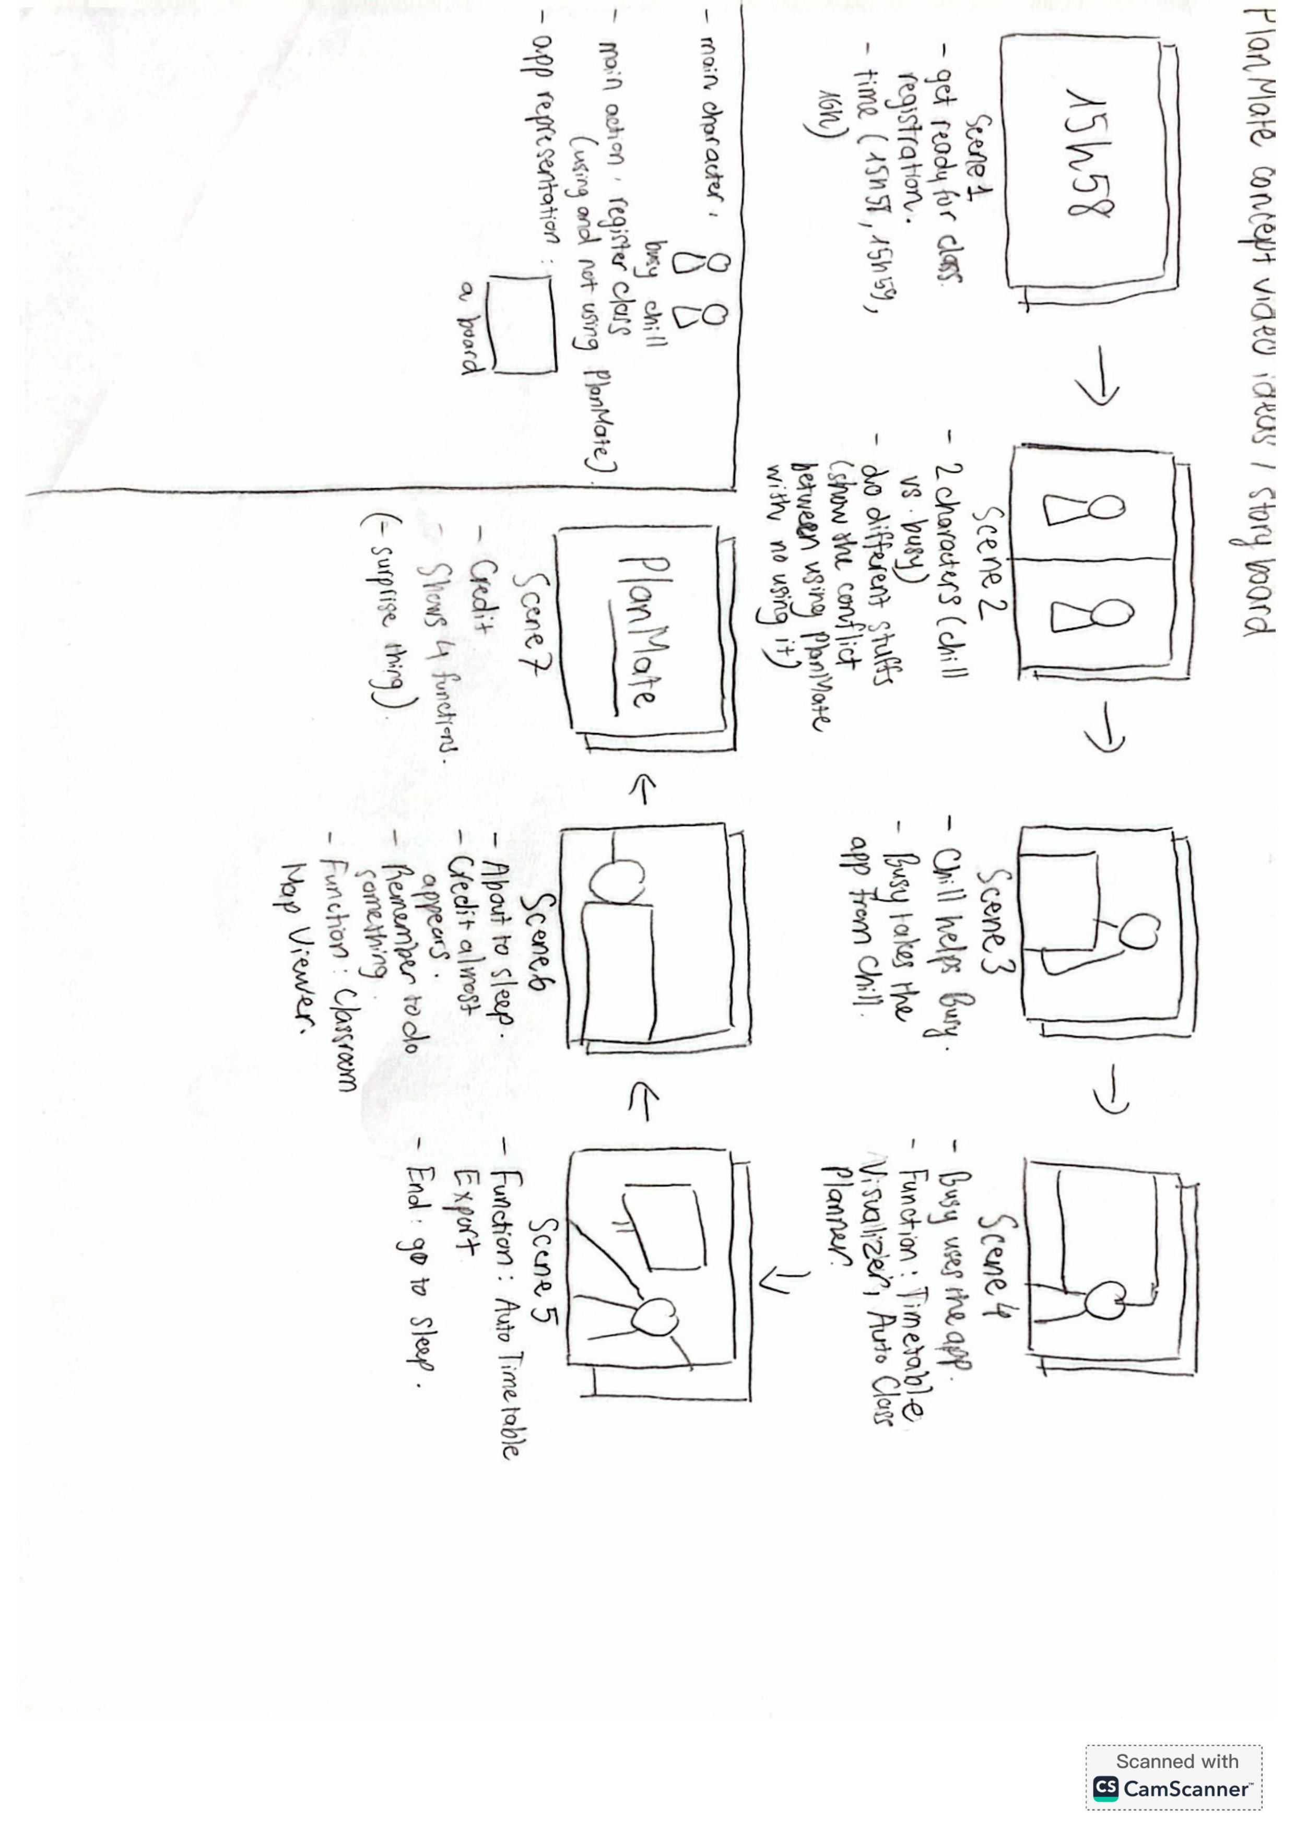
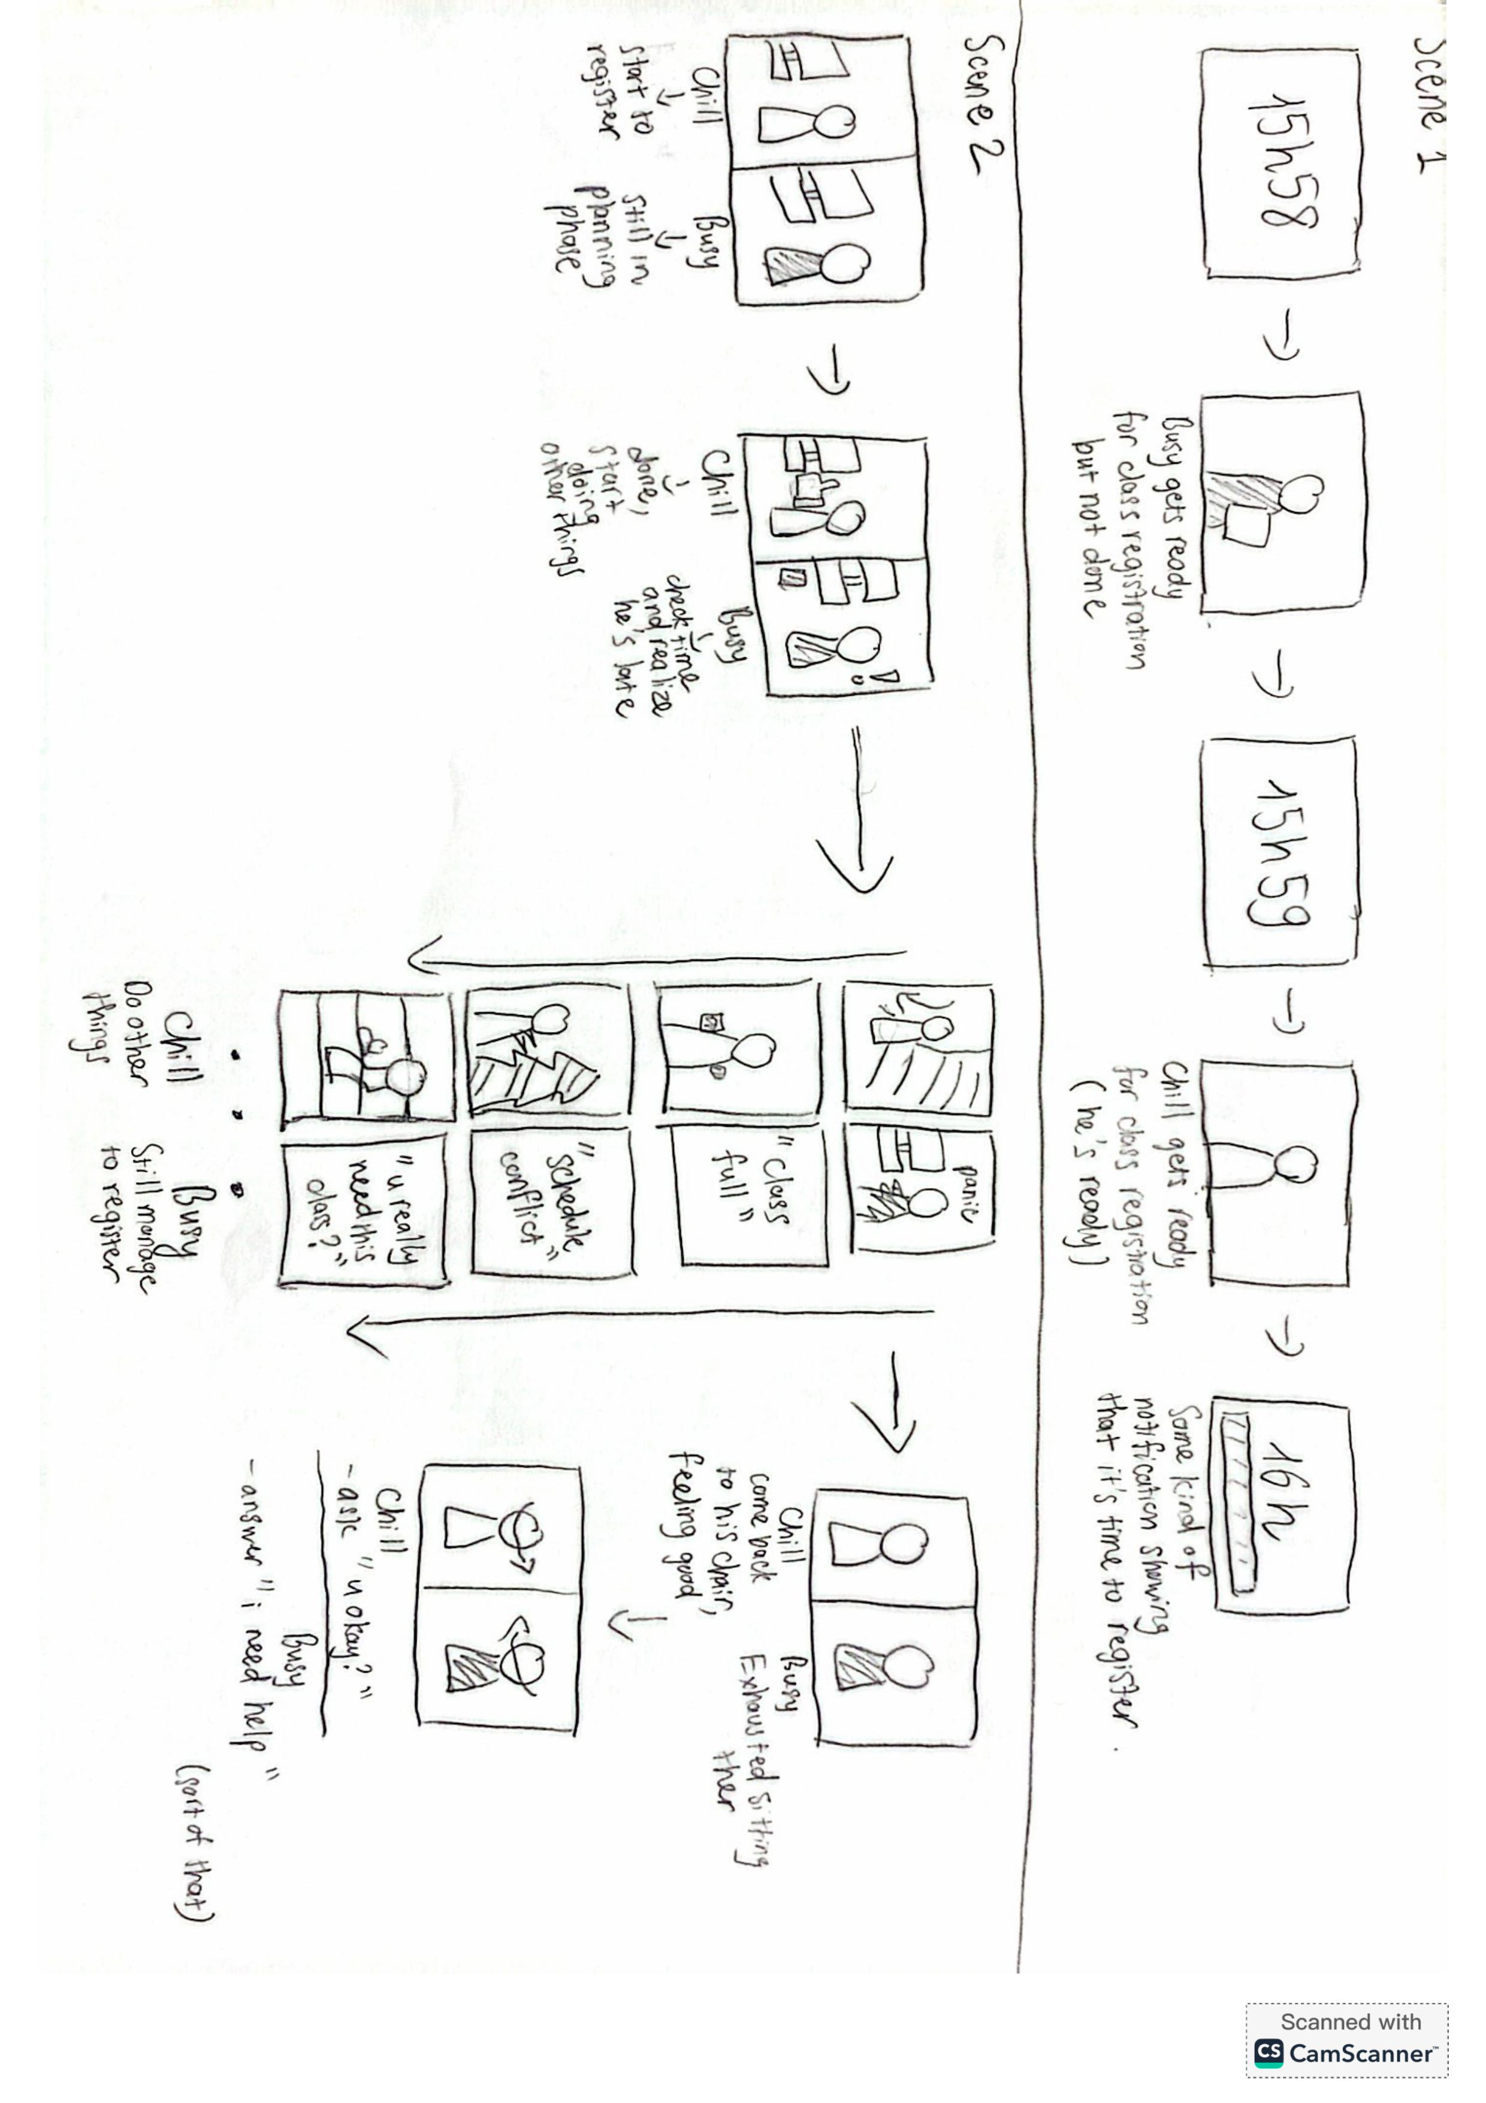

Slide 35
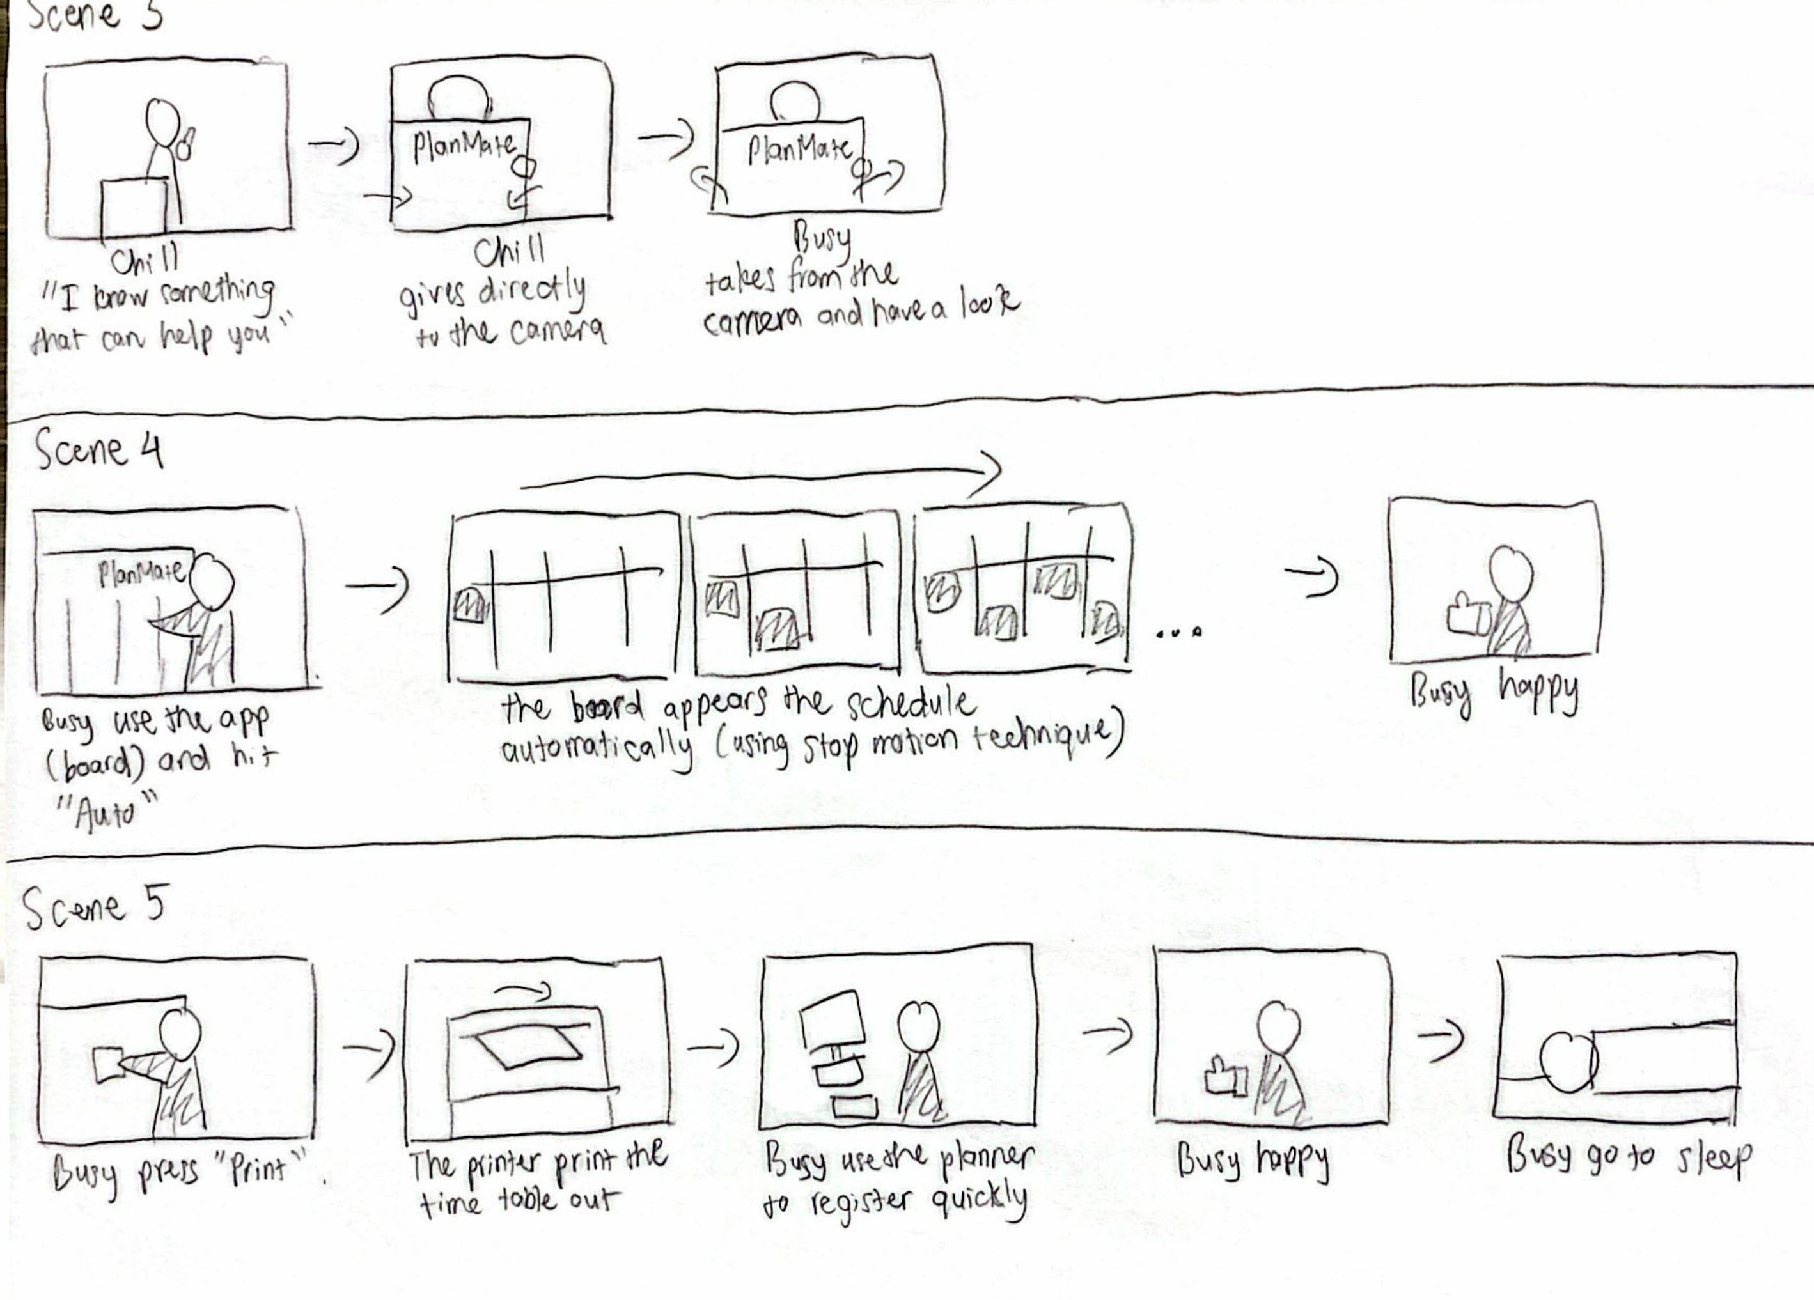

Slide 36
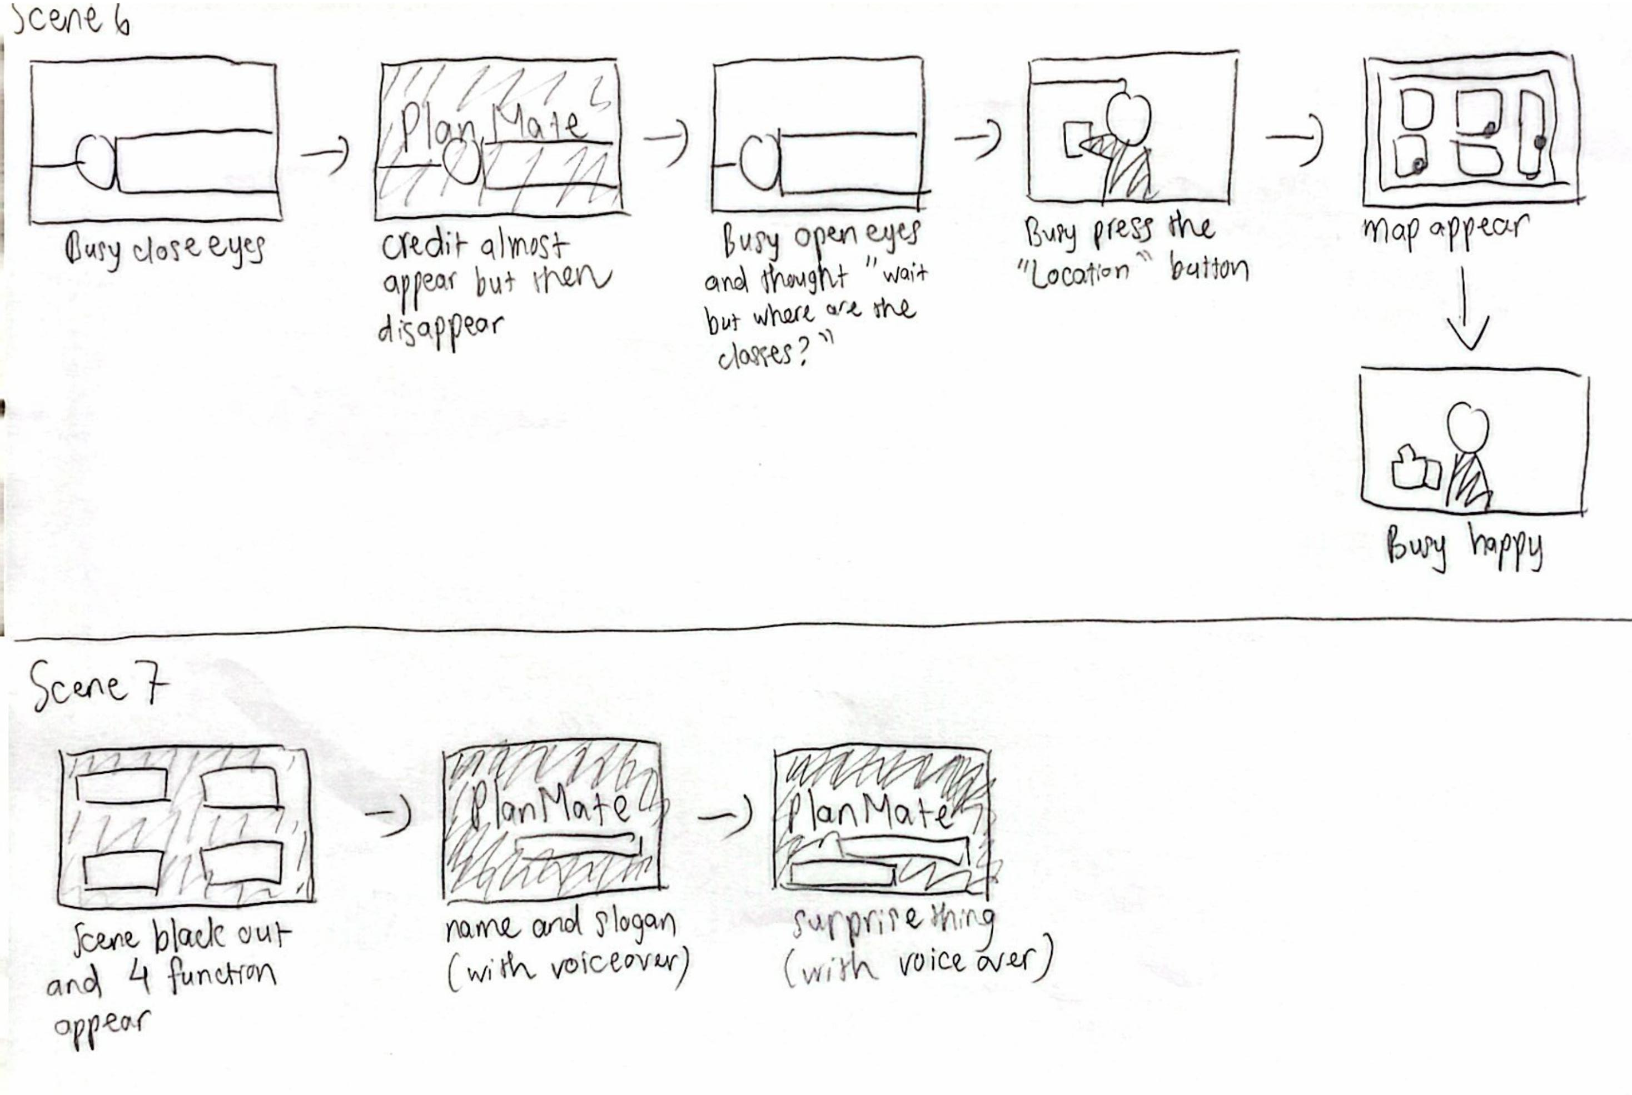

Slide 38

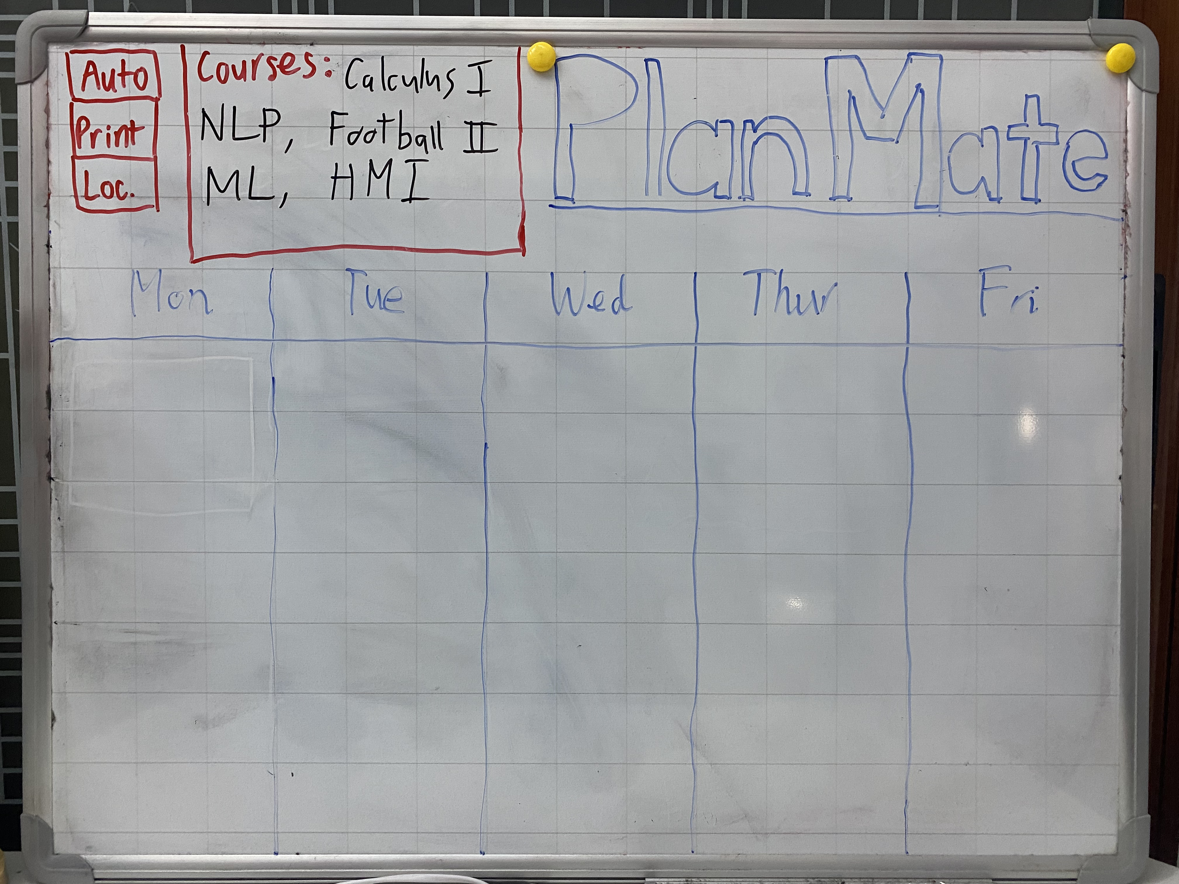


Split Screens
Overall Ideas
Characters
4 Functions Demonstration
Emphasize conflict between two sides.
Chill Guy
(Using PlanMate)
Busy Guy
(Not using PlanMate)
Timetable Visualizer.
Auto Class Planner.
Auto Timetable Export.
Classroom Map Viewer.

Slide 39

04
Design Evolution

Slide 40


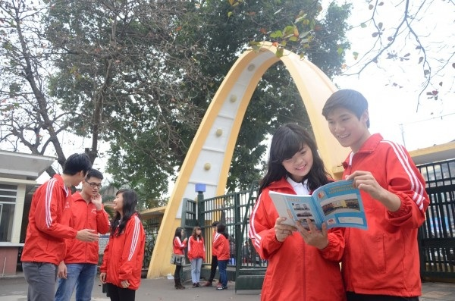
Stakeholders
Direct
HUST students.
System Developers.
School/University.
Indirect
Parents of Students.
Competitors (Other Scheduling Apps).
Student Clubs/Communities.

Slide 41

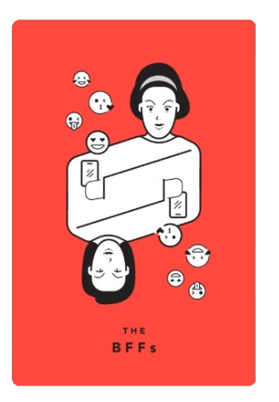

Ethical Implications

Slide 42
Ethical Implications

Slide 43
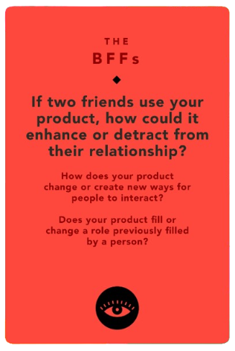
Ethical Implications

Slide 44
Ethical Implications

Slide 45
Ethical Implications
Enhances friendships by enabling trusted schedule sharing, making it easier to coordinate study or social activities.
Creates a new way to interact by automating timetable alignment, reducing the need for manual discussions.
Could detract if privacy concerns arise or the feature is misused.

Slide 46
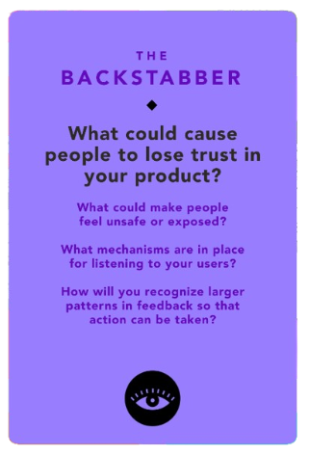
Ethical Implications

Slide 47
Ethical Implications

Slide 48
Ethical Implications
Trust issues could arise from data breaches or unauthorized schedule access.
Users may feel unsafe if schedules are accidentally shared or data handling lacks transparency.
Collect feedback via in-app surveys and dedicated support channels.
Analyze feedback trends to identify and prioritize common concerns for updates.

Slide 49


3 Task Flows
Simple Task
Moderate Task
Complex Task
Export the personalized
timetable to a PDF
View the campus map
with class locations
Automatically generate and
view a personalized
timetable

Slide 50
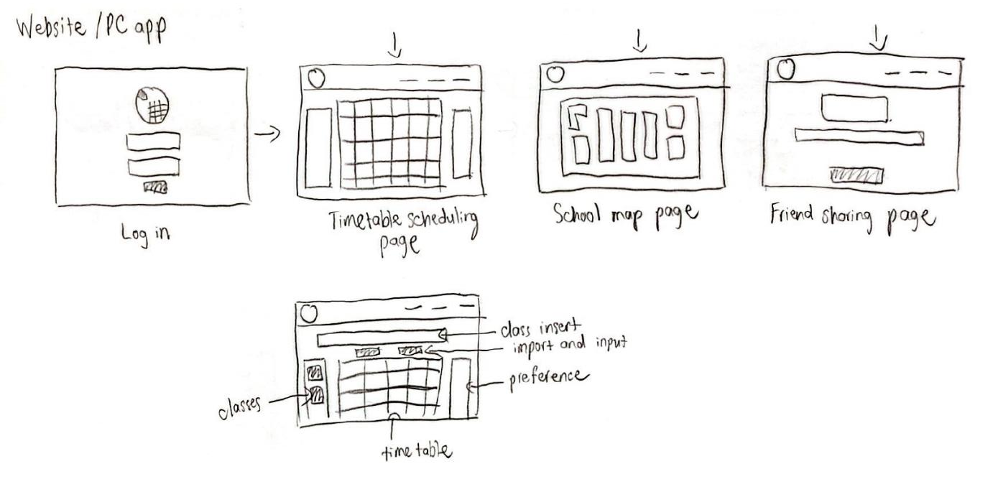

Concept 1: Website/PC App

Slide 51
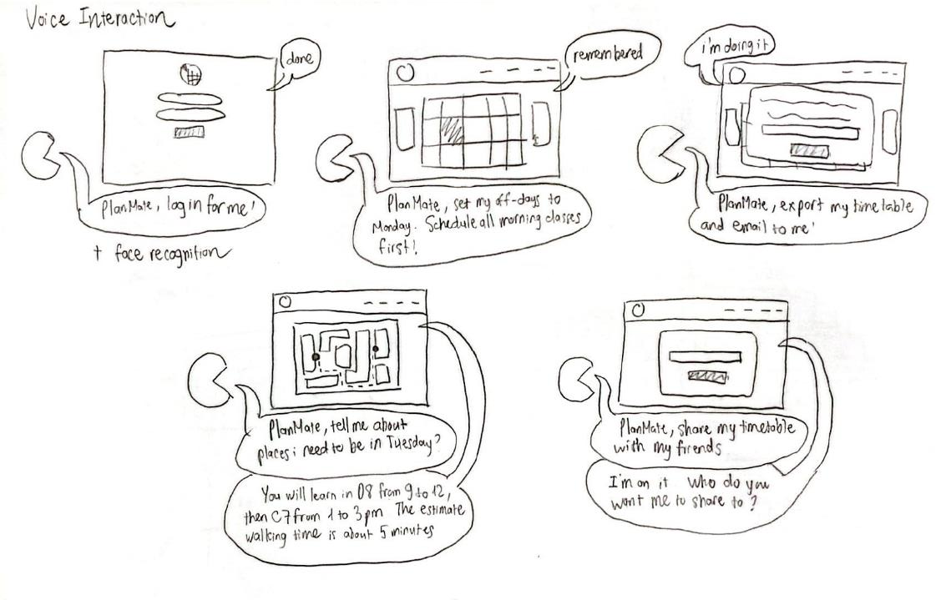
Concept 2: Voice Interaction

Slide 52
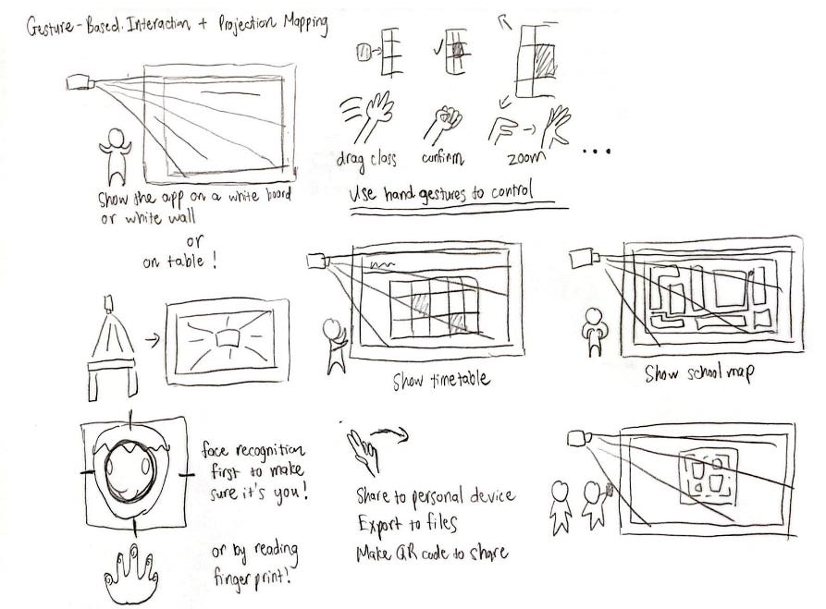
Concept 3: Gesture-Based Interaction +
Projection Mapping

Slide 53
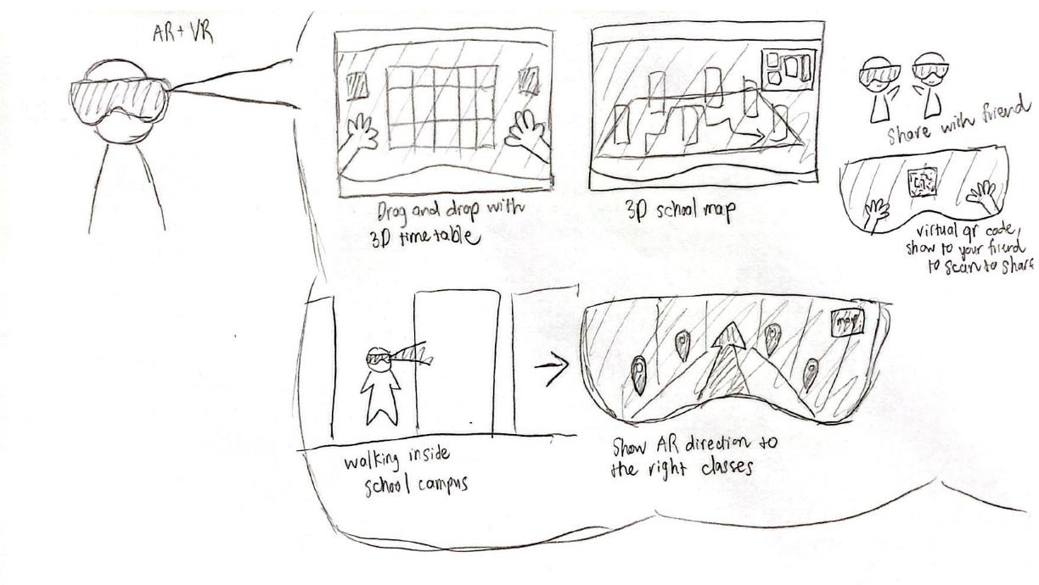
Concept 4: AR + VR Walkthrough

Slide 54
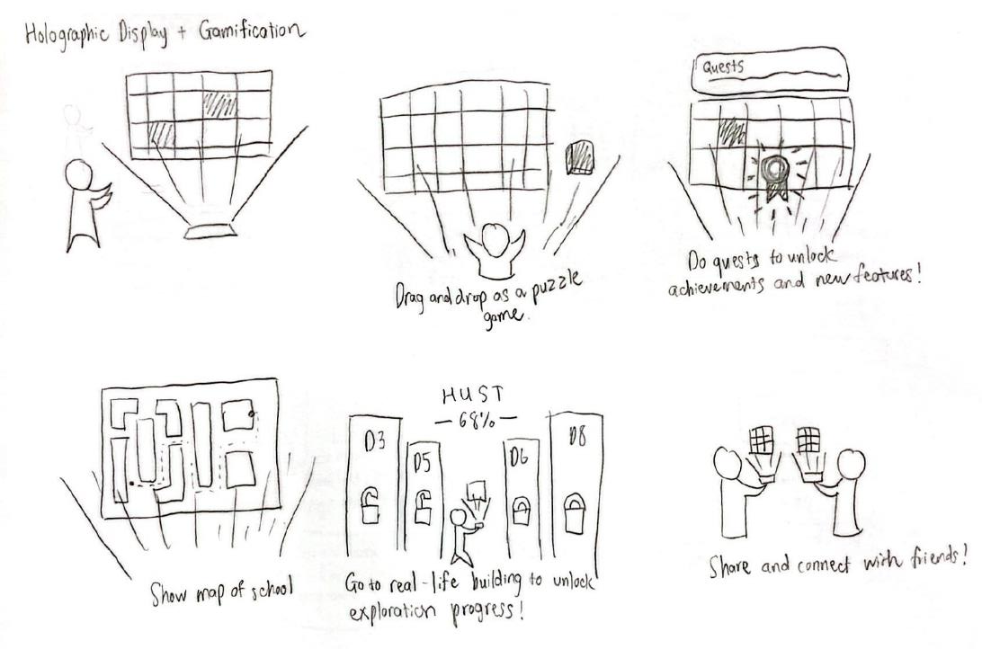
Concept 5: Hologram Display + Gamification

Slide 55
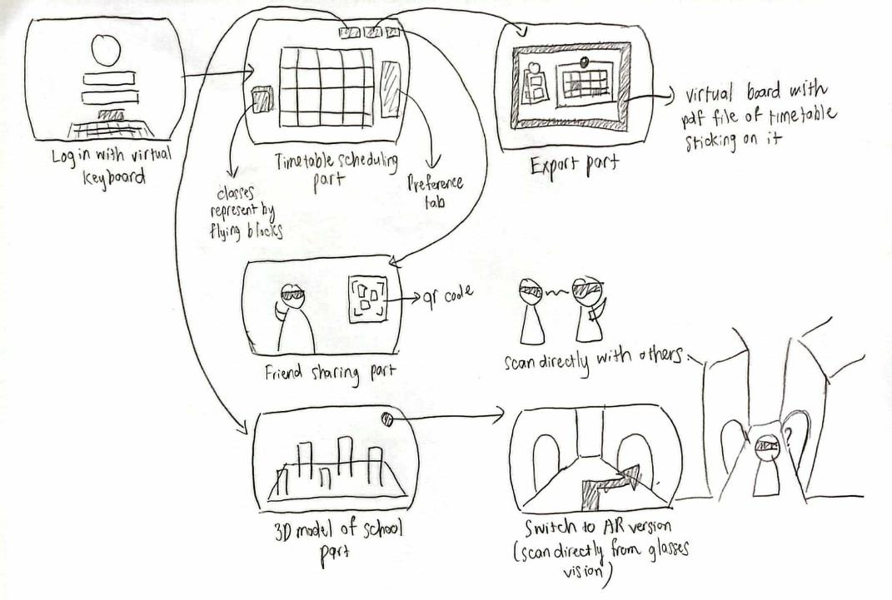
AR + VR Walkthrough

Slide 56


Pros
Cons
Immersive Experience: Enhances user engagement through interactive 3D visuals.
Intuitive Navigation: Helps students explore and plan using spatial interactions.
Innovative Appeal: Attracts tech-savvy users with cutting-edge features.
High Barriers to Access: Requires AR/VR-capable devices, limiting adoption.
Costly Development: Significant investment in hardware and 3D design.
Complex for New Users: Non-tech-savvy students may face challenges.

Slide 57
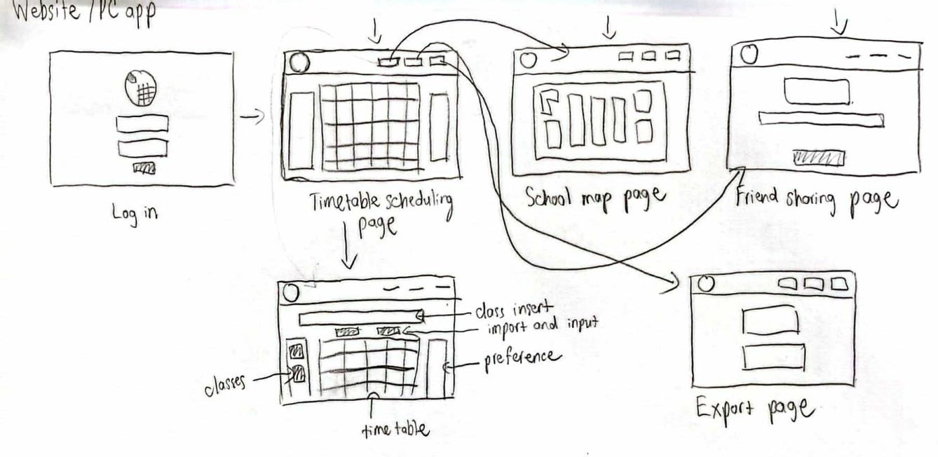
Website/PC App

Slide 58
Pros
Cons
Wide Accessibility: Works on any browser or device, no extra hardware needed.
User-Friendly Design: Familiar interface ensures ease of use for all students.
Cost-Effective: Lower development and maintenance expenses.
Lacks Immersion: Provides a functional but less engaging experience.
Risk of Overcrowding: Overloaded screens may confuse some users.
Limited Interactivity: Offers fewer innovative features compared to AR/VR.

Slide 59
Comparisons
Aspect | AR + VR | Website/PC App
User Engagement | High immersion, engaging interactivity. | Moderate engagement, practical interface.
Ease of Access | Device-dependent, costly setup. | Accessible to all students.
Cost and Development | High development and hardware costs. | Moderate costs with easier maintenance.
Learning Curve | Steep for some users; tech-heavy. | Easy to use; familiar interface.
Scalability | Hard to scale without specialized devices. | Highly scalable with minimal restrictions.

Slide 60
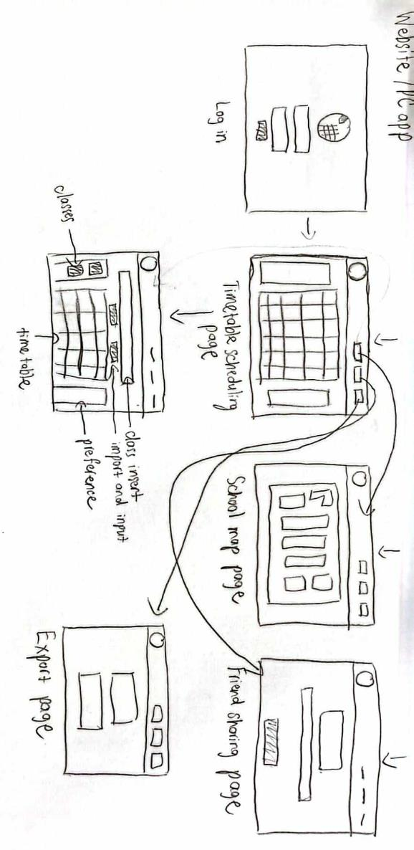



Selected Interface

Slide 61
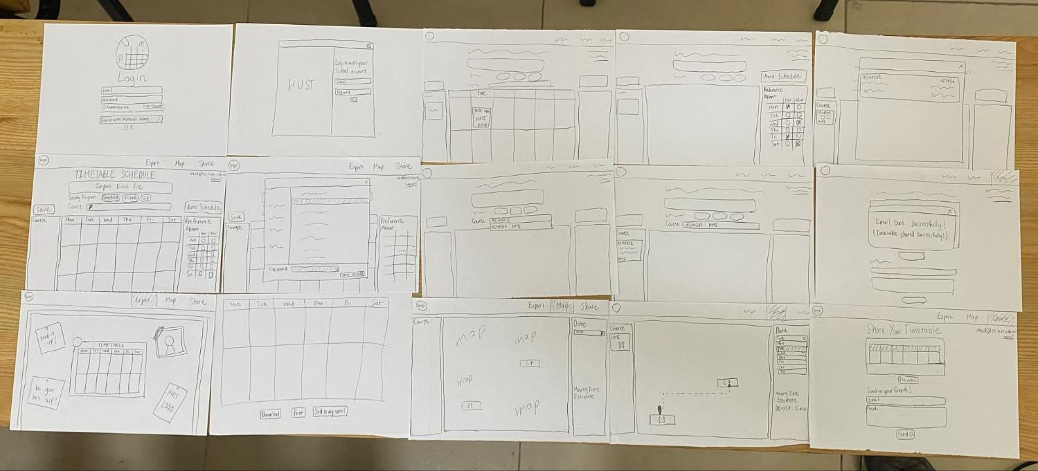
Low-fi Prototype

Slide 62
Low-fi Prototype

Slide 63
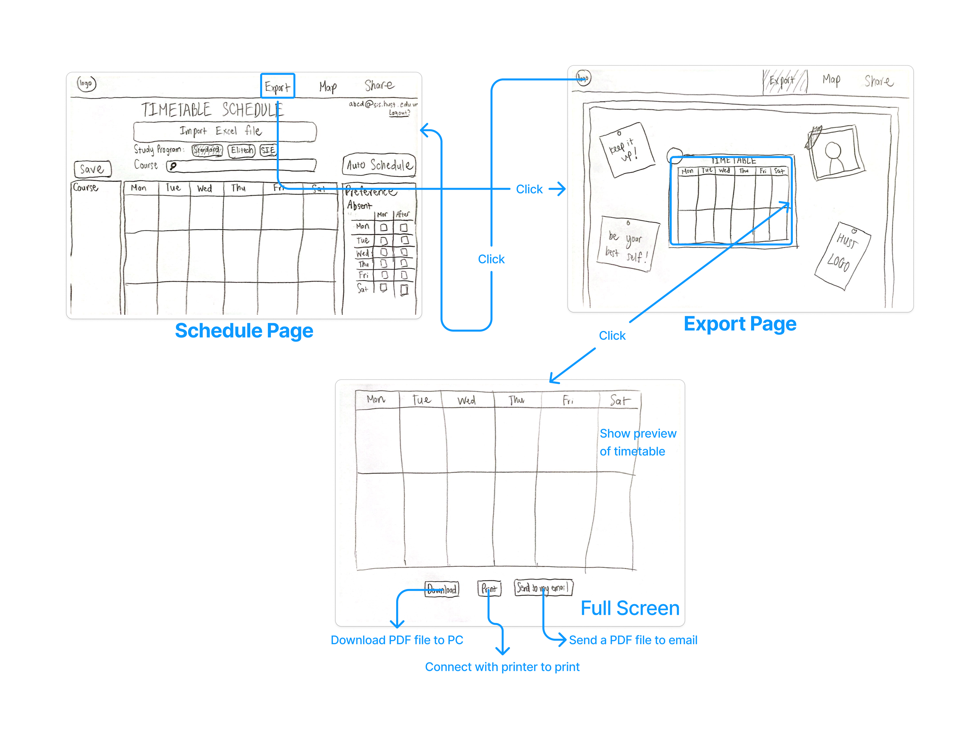
Simple Task Flow
Export the personalized
timetable to a PDF

Slide 64
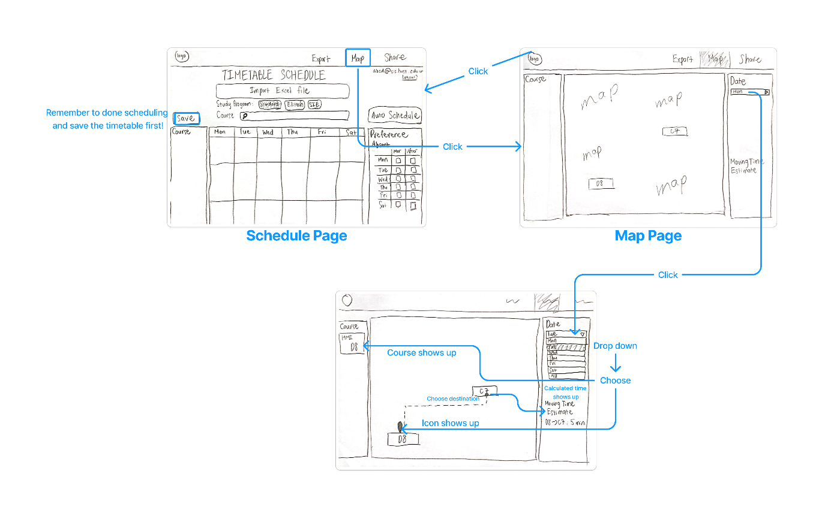
Moderate Task Flow
View the campus map
with class locations

Slide 65
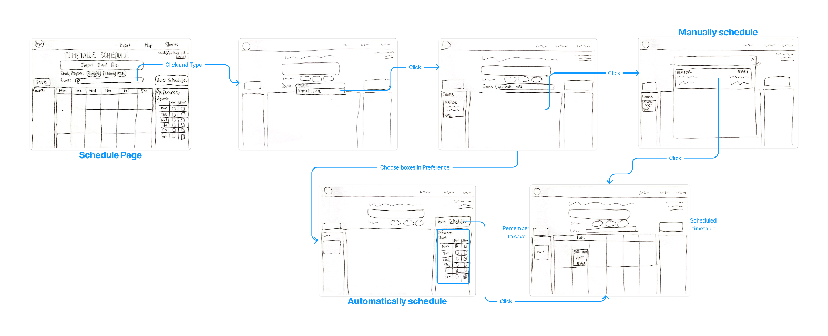
Complex Task Flow
Automatically generate and
view a personalized
timetable

Slide 66



Duy
My
Nhi
Usability Testing
(20)
SOICT, HUST, Hanoi
(21)
Banking Academy, Hanoi
(21)
University of Exeter, England

Slide 67
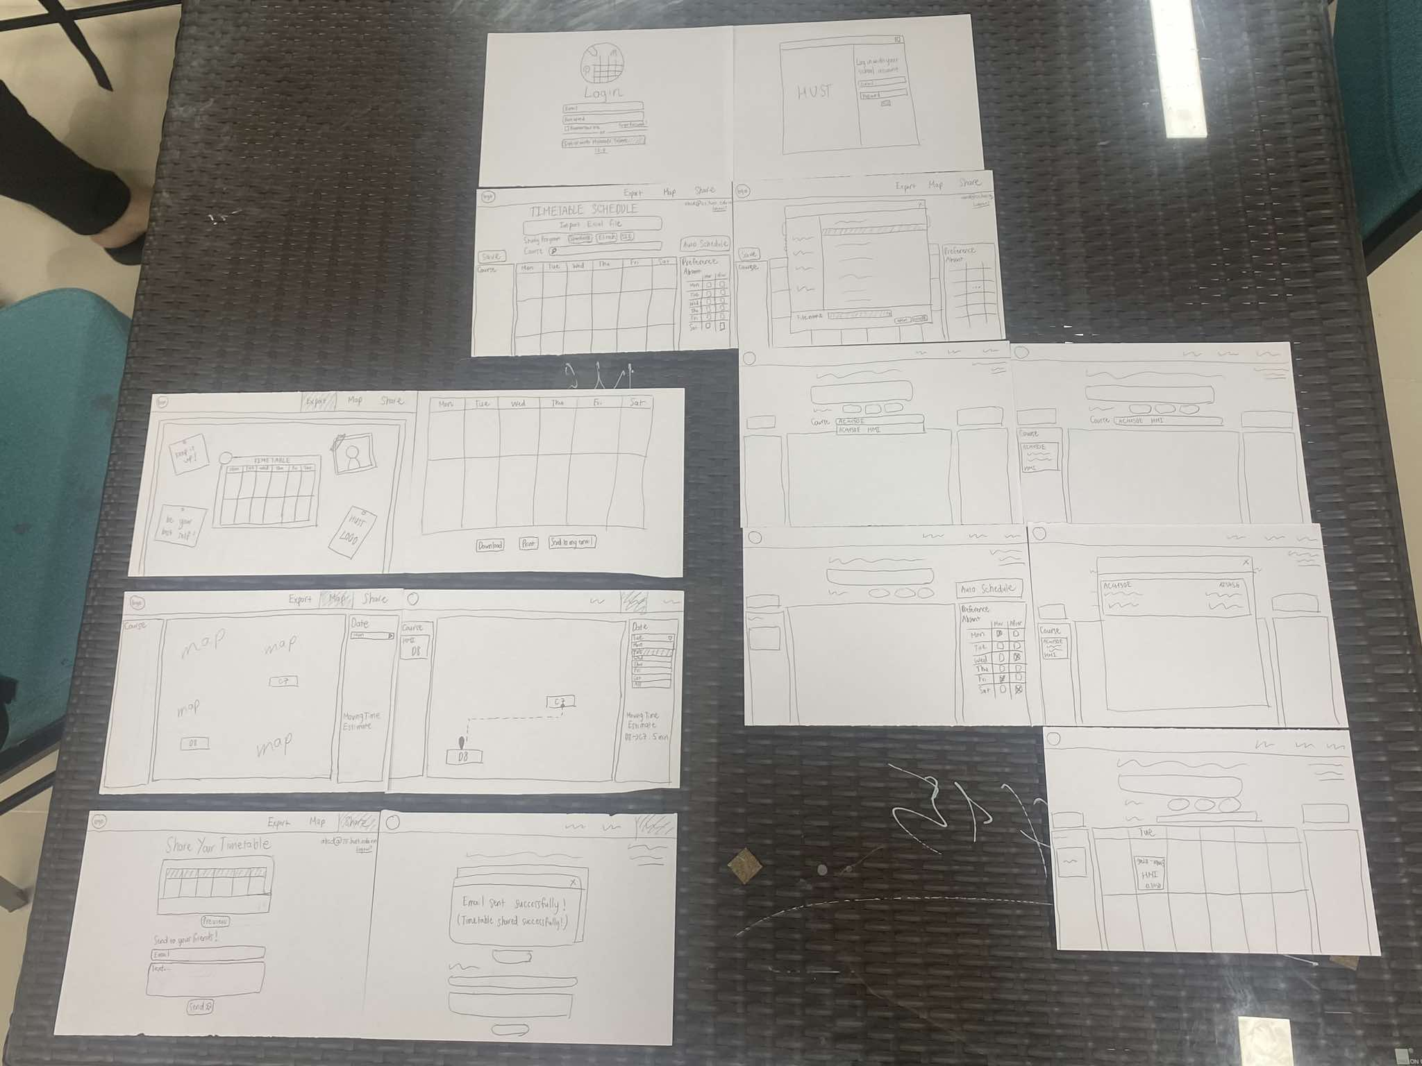
Environment & Apparatus
We created a paper prototype and simulated user interactions manually.
The prototypes were arranged on a table, and participants interacted with them following our script.

Slide 68
Procedure & Progress
Introduction
Welcome participant and explain purpose (testing PlanMate prototype).
Emphasize testing the prototype, not their skills.
Obtain consent for participation and note-taking.
Arrange paper prototype elements logically.
Explain roles (facilitator, computer, observer).
Briefly outline the 3 tasks.
Set Up

Slide 69
Procedure & Progress
Task Execution
Task 1: Export timetable to PDF.
Task 2: View campus map with class locations.
Task 3: Generate and view personalized timetable.
Observe user behavior and note challenges.
Ask about likes, dislikes, and moments of confusion.
Collect suggestions for improvement.
Thank participant and explain how feedback will help refine PlanMate.
Feedback
Conclusion

Slide 70
Usability Goals and Metrics
1) Efficiency
Goal: Participants should complete tasks quickly and without unnecessary steps.
Key Measurement: Time taken to complete each task (measured in minutes and seconds).
2) Clarity and Intuitiveness
Goal: The interface should be easy to understand and navigate.
Key Measurement:
Number of errors (e.g., choosing the wrong feature or being unsure of what to do).
Participant feedback on clarity (e.g., a 1-5 scale on how intuitive they found the prototype).

Slide 71

Process Data
Task 1: Export Timetable to PDF
Common Feedback:
Strength: The export function is straightforward once users locate the correct button.
Issues:
Two participants misclicked the ‘Share’ button at least once, confusing it with Export.
The ‘Export’ button was described as hard to find and not prominent enough.
-> Mostly functional but lacks visibility for key buttons.

Slide 72
Process Data
Task 2: View Campus Map with Class Locations
Common Feedback:
Strength: The map feature has strong potential and was positively received conceptually. Participants liked the idea of estimating travel time between classes.
Issues:
Navigation between tabs was a little bit hard to do.
The travel time estimation lacked clarity—users were unsure where to start or select endpoints.
-> Conceptually strong but needs better guidance for user actions.

Slide 73
Process Data
Task 3: Generate and View Personalized Timetable
Common Feedback:
Strength: Participants found the concept of auto-generating a timetable appealing and thought it would save significant time during course registration.
Issues:
Preferences setup was confusing, with a user misinterpreting it as manual selection instead of automated planning.
The ‘Save’ button was overlooked by all participants due to its placement and lack of visibility.
-> Valuable feature but struggles with unclear preferences and save functionality.

Slide 74
Bottom-line Data
Usability Goals Achievement Summary
Efficiency (Score: 3.5/5):
Achieved: Basic tasks were completed, but not efficiently. Misclicks and navigation confusion slowed down completion times.
Not Achieved: Several users needed to backtrack or retrace steps, which led to delays across all tasks.
Clarity and Intuitiveness (Score: 3/5):
Partially Achieved: The app had potential, but users required significant trial-and-error to complete tasks. Errors due to unclear button placements, and task confusion were common.
Not Fully Achieved: The prototype's lack of step-by-step instructions and misplacement of buttons significantly hindered task clarity.

Slide 75
Bottom-line Data
Implications
Button Placement & Labeling: Misclicks show the need for better visual hierarchy and clear labeling to reduce errors.
Navigation Improvements: Adding a ‘Home’ tab or breadcrumb trails can simplify task transitions and enhance user flow.
Guidance for Complex Features: Tasks like setting preferences and using the map require tooltips or instructions to guide users, especially first-timers.

Slide 76
Bottom-line Data
Changes
Button Redesign: Position critical buttons prominently and use consistent design patterns. Maybe add confirmation messages after actions.
Enhanced Navigation: Add a ‘Home’ tab for easy access to the main page and breadcrumbs to show user location within the app.
Feature Guidance: Provide tooltips or tutorials for the ‘Preferences’ setup and ‘Travel Time Estimation’. Improve map annotations with clearer start/end points.

Slide 77

Bottom-line Data
What’s Testing Couldn’t Reveal
Aesthetic Appeal: The lack of color and final design elements means user opinions on the visual design were not assessed.
Long-Term Usability: Testing was done on first-time use; how users adapt or perform over time was not evaluated.
Performance Under Load: The prototype didn’t simulate real-world usage, so performance and scalability remain untested.
Edge Cases: Scenarios like conflicting preferences or incomplete timetable files were not fully explored.

Slide 78
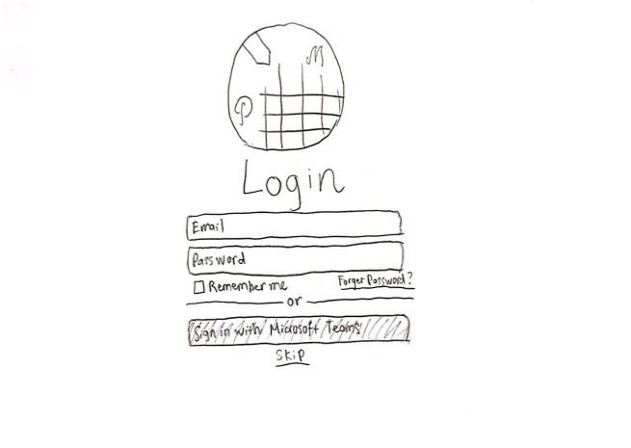
Change 1: Login Page
Before

Slide 79
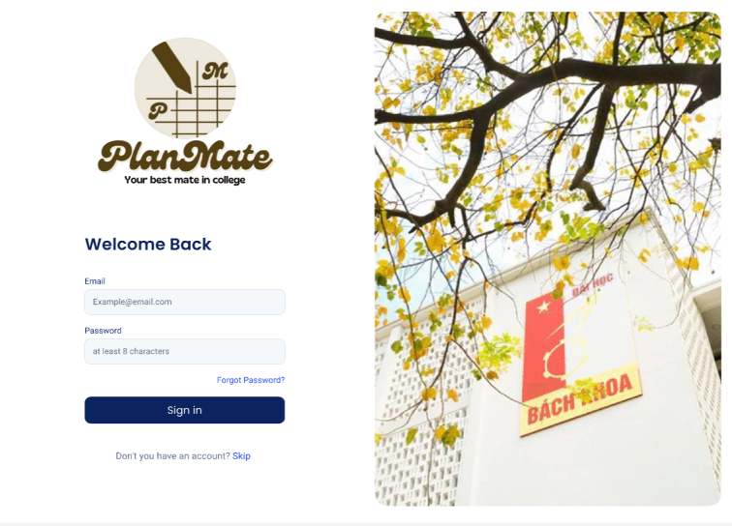
Change 1: Login Page
Move to the left
New!
After

Slide 80
Change 1: Login Page
Changes
Move the login box to the left
To create a more balanced layout and ensure better visual flow, improving user experience.
Add an image of HUST campus to the right
Increases brand recognition and creates a more familiar and engaging environment for users.

Slide 81
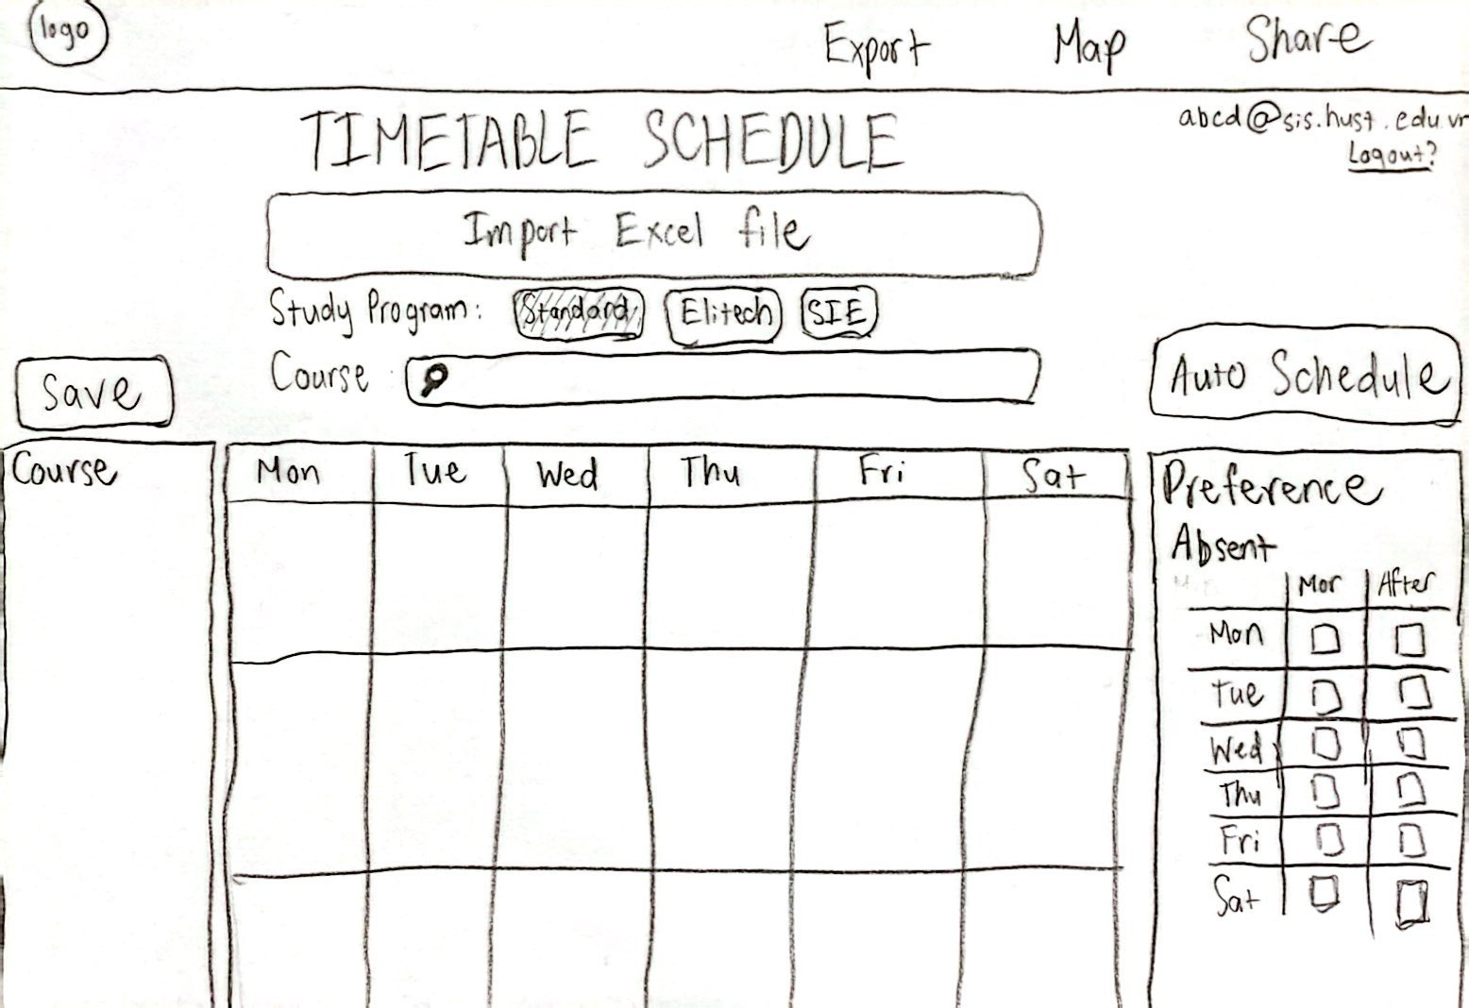
Change 2: Timetable/Schedule Page
Before

Slide 82
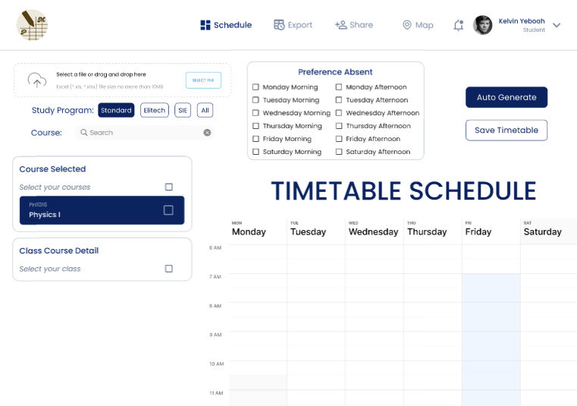
Change 2: Timetable/Schedule Page
New
New
Move to the left
Rearrange buttons
Move to the right
After

Slide 83
Change 2: Timetable/Schedule Page
Changes
Add a "Schedule" page button (instead of using the logo)
Provides clearer navigation and makes it easier to return to the schedule.
Move the "Upload File" and "Search Course" sections to the left
Creates a more organized layout and improves accessibility.
Move the "Preferences" section to the left and adjust checkbox options
Improves readability by separating options, making it more user-friendly.
Reorganize the "Auto Generate" and "Save" buttons close together
Enhances efficiency by grouping key actions for quicker completion.
Shift the timetable slightly to the right
Creates a balanced, natural visual flow after layout adjustments.
Add a button/tab for the profile instead of email/logout in the corner
Improves accessibility to profile and logout options, enhancing navigation.

Slide 84
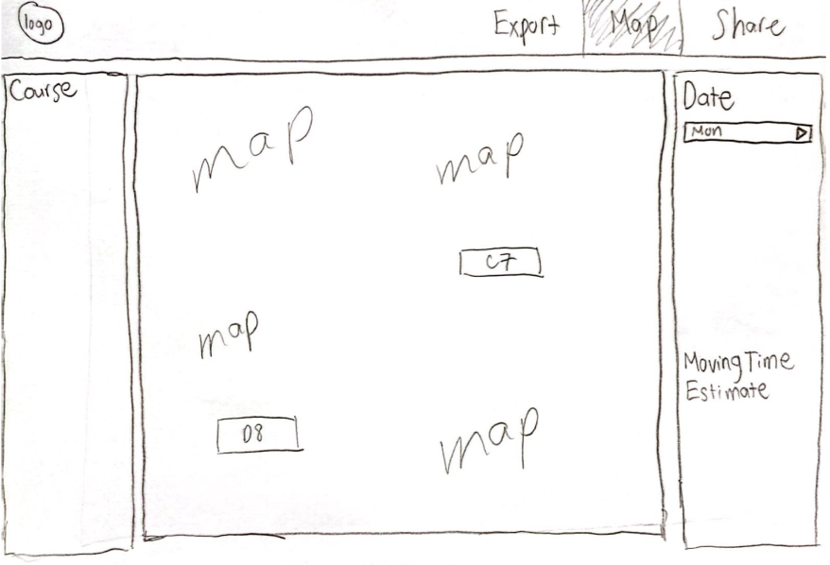
Change 3: Map Page
Before

Slide 85
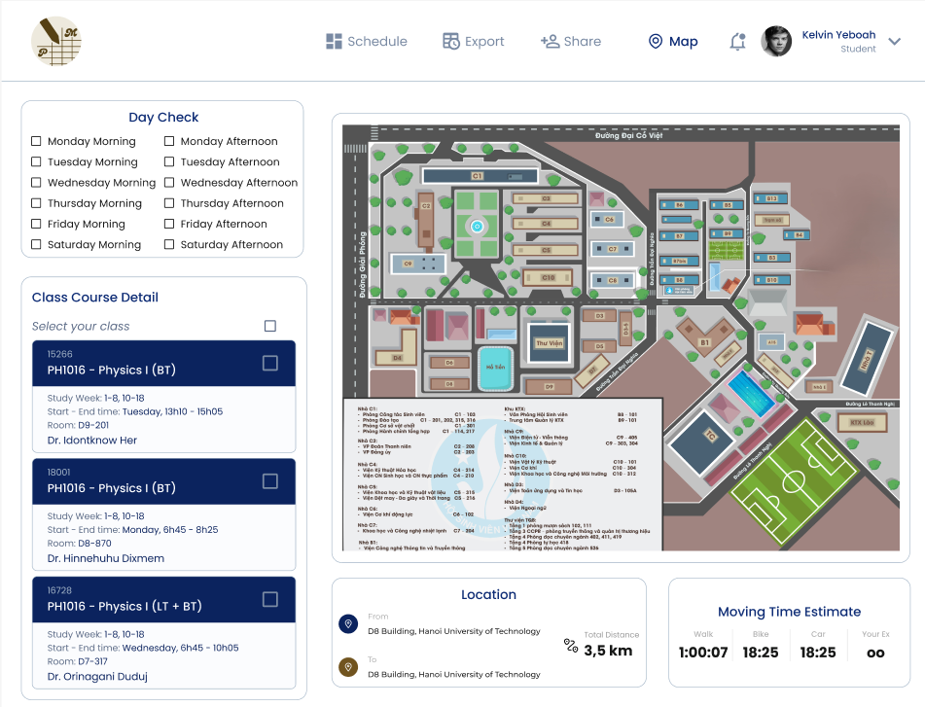
Change 3: Map Page
Move to the left Change into checkboxes
Move to the right
Separate from the “Day Check” box
Move down here
After

Slide 86
Change 3: Map Page
Changes
Move "Day Check" to the left and replace the dropdown with checkboxes
Synchronizes with the course schedule selection, making it more intuitive and consistent.
Separate "Moving Time Estimate" from "Day Check" and move it to the bottom, adding extra details
Improves clarity by isolating time estimates and providing additional information for better planning.
Shift the map to the right
Creates a more balanced layout after rearranging the elements.

Slide 87
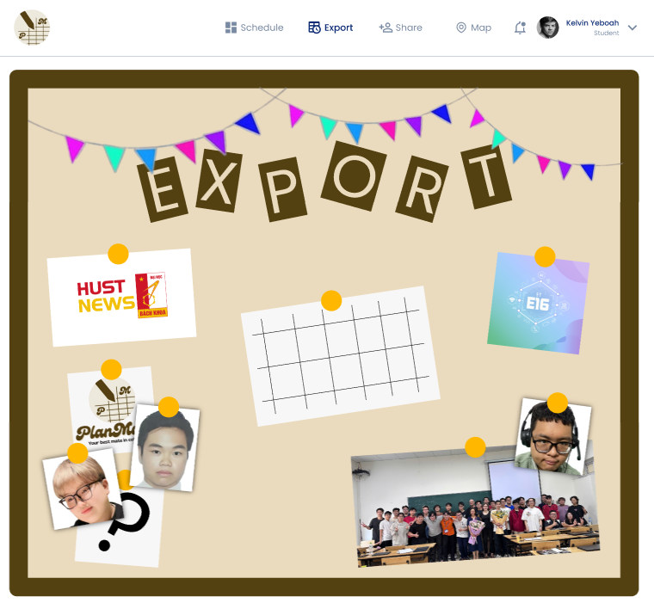
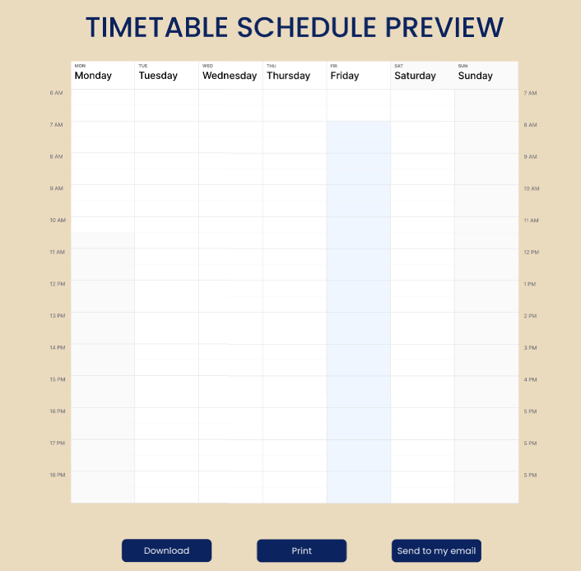
Simple Task Flow
Export the personalized
timetable to a PDF
[Click “Export” tab]
[Click the picture of the timetable]
[Click “Download” button]

Slide 88
Moderate Task Flow (1)
View the campus map
with class locations
[Click “Map” tab]

Slide 89
Moderate Task Flow (2)
View the campus map
with class locations
[Choose wanted days in “Day Check” checkboxes]
[Choose wanted courses to see the classes]
[The map displays the classes and estimate moving time shows up]

Slide 90
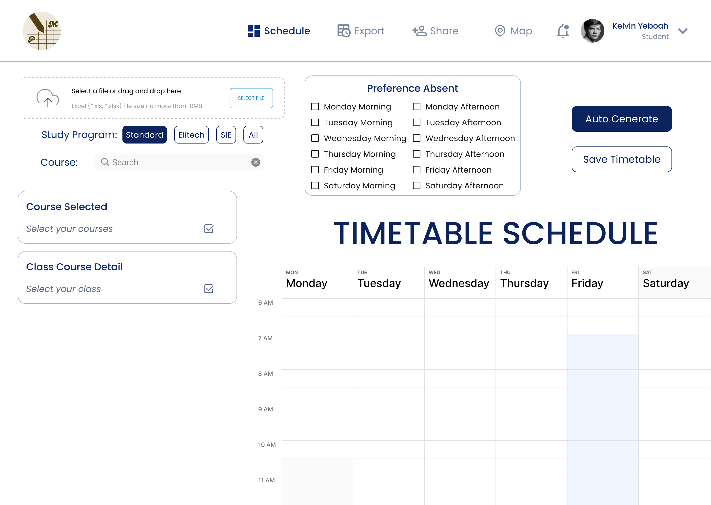
Complex Task Flow (1)
Automatically generate and
view a personalized
timetable
[Click to import Excel file]
[Check the Study Program and Search for the course’s name]

Slide 91
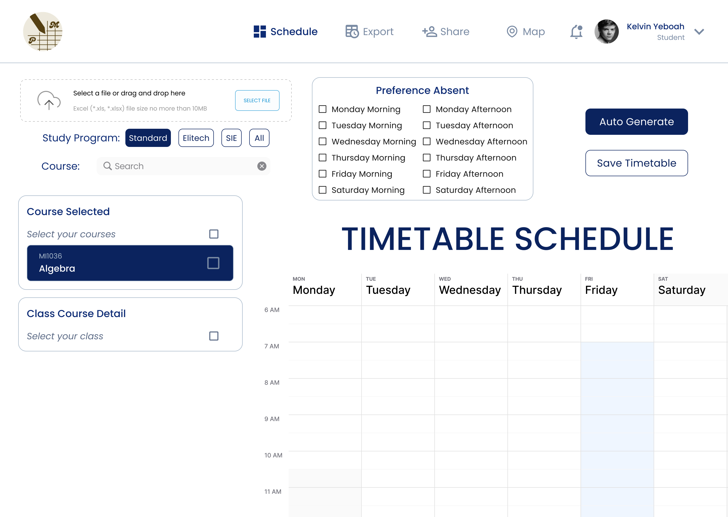
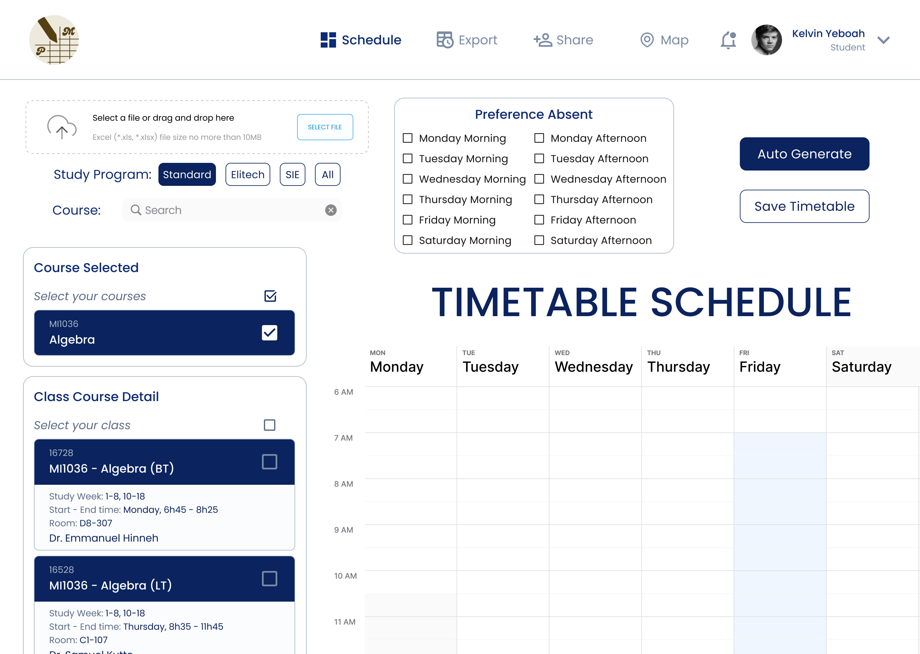
Complex Task Flow (2)
Automatically generate and
view a personalized
timetable
[Choose the course to show more information]
[The details of the classes of that course show up]

Slide 92
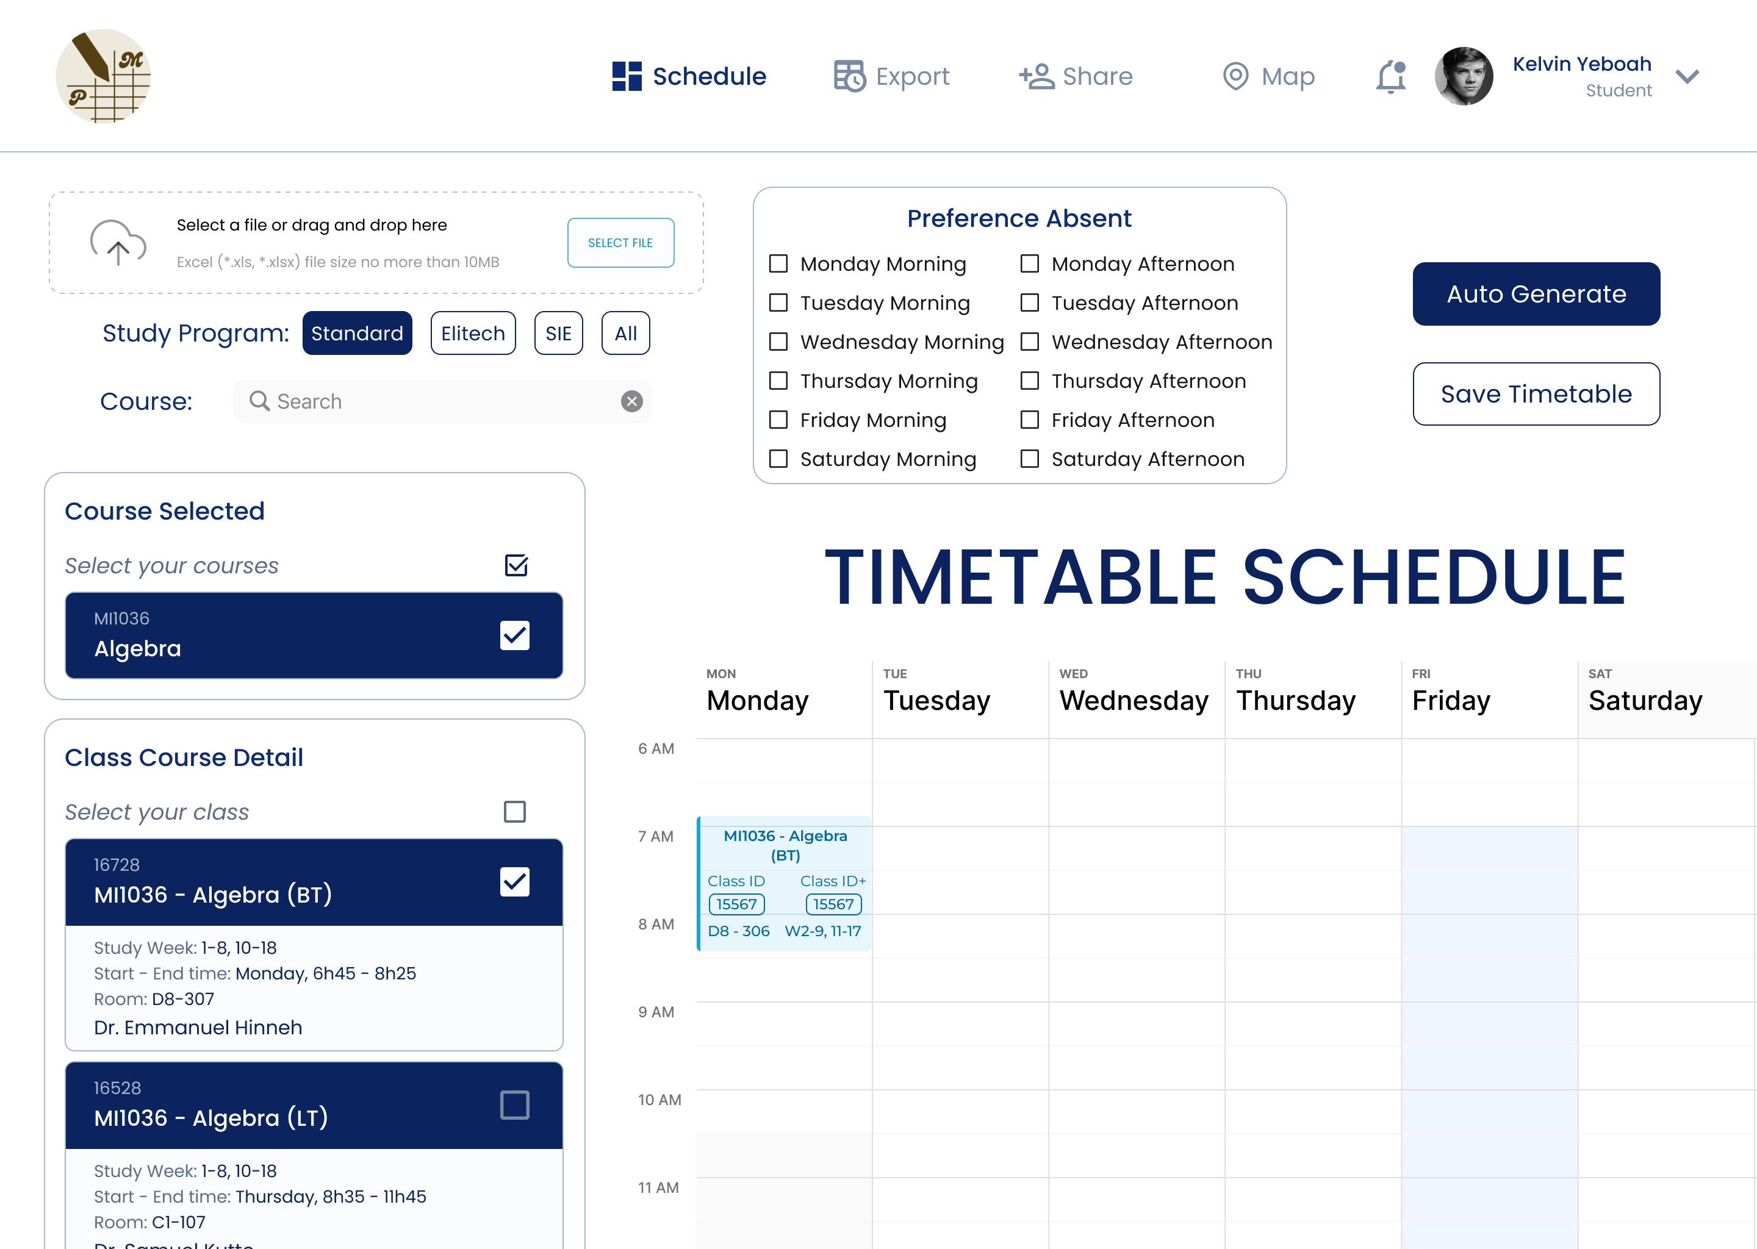
Complex Task Flow (3)
Automatically generate and
view a personalized
timetable
[Check the boxes from the “Preference Absent” checkboxes]
[Click on the “Auto Generate” button]
[The timetable automatically schedules, also the chosen class is checked]
P/S: Remember to click “Save Timetable” for further uses!

Slide 93
Heuristic Evaluation
Category | # Viol. (sev 0) | # Viol. (sev 1) | # Viol. (sev 2) | # Viol. (sev 3) | # Viol. (sev 4) | # Viol. (total)
H1: Visibility of System Status | 0 | 0 | 1 | 2 | 0 | 3
H2: Match between System & Real World | 0 | 0 | 2 | 1 | 0 | 3
H3: User Control & Freedom | 0 | 0 | 1 | 2 | 0 | 3
H4: Consistency & Standards | 0 | 0 | 3 | 0 | 0 | 3
H5: Error Prevention | 0 | 0 | 0 | 3 | 0 | 3
H6: Recognition Rather Than Recall | 0 | 0 | 0 | 3 | 0 | 3
H7: Flexibility & Efficiency of Use | 0 | 0 | 5 | 0 | 0 | 5
H8: Aesthetic & Minimalist Design | 0 | 3 | 0 | 0 | 0 | 3
H9: Recognize, Diagnose, & Recover from Errors | 0 | 0 | 0 | 1 | 1 | 2
H10: Help & Documentation | 0 | 0 | 1 | 0 | 0 | 1
Total Violations by Severity | 0 | 3 | 13 | 12 | 1 | 29

Slide 94
Heuristic Evaluation
Severity / Evaluator | Bao | Minh | Phong
% Sev. 0 | 0% | 0% | 0%
% Sev. 1 | 33.33% | 33.33% | 33.33%
% Sev. 2 | 53.85% | 30.77% | 53.85%
% Sev. 3 | 8.33% | 25% | 66.67%
% Sev. 4 | 0% | 100% | 0%
Total (Sev. 3 & 4) | 7.69% | 30.77% | 61.54%
Total (all severity levels) | 31.03% | 31.03% | 55.17%

Slide 95
Heuristic Evaluation
13 issues with severity 3 and 4:
H1 Visibility of System Status (2 issues): Users may not receive timely feedback, leading to confusion.
H2 Match Between System and the Real World (1 issue): Some design elements don’t align with user expectations, affecting intuitiveness.
H3 User Control and Freedom (2 issues): Lack of options to undo or escape actions, causing frustration.
H5 Error Prevention (3 issues): Design elements fail to prevent user mistakes, increasing error-proneness.
H6 Recognition Rather than Recall (3 issues): Users are forced to remember information, raising cognitive load.
H9 Error Recovery (2 issues): Insufficient error diagnosis and recovery support for users.

Slide 96
Identified Values
Intuitiveness
Personalization
Efficiency
Spatial Awareness
Students should quickly
understand how to use the
website without needing instructions.
Different students have
different scheduling needs,
so flexibility is crucial.
Students need to organize
timetables quickly to save
time during course
registration.
Knowing where classes are
located helps students plan
their day effectively.

Slide 97
Value-Aligned Features
Intuitiveness
Personalization
Efficiency
Spatial Awareness
Drag-and-drop Excel upload
with instant confirmation.
Set custom preferences like
off-days or study times.
Auto-generate timetable based
on user preferences.
Campus map showing class
locations clearly.

Slide 98
Conflicting Values
Simplicity vs. Customization
Clarity vs. Visual Balance
Efficiency vs. Comprehensiveness
Streamlined Design vs. User Needs for Detail
Balancing ease of use with
user control over
personalizing the system.
Enhancing clarity may disrupt
visual harmony.
Striving for a fast,
efficient interface without
sacrificing detailed
functionality.
Simplified design vs. the
need for detailed
information.

Slide 99
Value-Aligned Features
Simplicity vs. Customization
Clarity vs. Visual Balance
Efficiency vs. Comprehensiveness
Streamlined Design vs. User Needs for Detail
Simple default settings with
options for color and layout
adjustments.
Clearer elements, but slight
layout imbalance.
Streamlined layout with
drill-down options for more
details.
Key features visible, with
optional detailed views.

Slide 100


05
Final Prototype Implementation

Slide 101

Design And Prototyping Tools
Pros
Collaborative: Real-time feedback and team collaboration.
Interactive: Create clickable prototypes for testing.
User-Friendly: Easy to design and prototype without advanced skills.
Cloud-Based: Accessible from anywhere, enabling remote work.
Cons
Limited Interactivity: Can't fully simulate advanced user flows.
Performance: Large files may slow down.
Not Fully Realistic: Doesn’t replicate the full app experience.

Slide 102
Limitations And Trade-offs
No Specific User Profiles: Lacks personalized user data or profiles.
Incomplete Button Implementation: Some buttons are not fully functional, limiting interactions.
Limited Search and Import Features: Search and import course functions are not fully developed.
Incomplete Map Functionality: The map does not display all locations or features yet.
Limited Testing Scenarios: User flows and behaviors can't be fully tested as the prototype is not fully interactive.

Slide 103
Wizard-of-Oz
Course Search: Manually simulate the search results when users input a query, even if the search function isn't fully implemented.
Timetable Generation: Simulate automatic timetable creation by manually arranging courses, as the algorithm for auto-generating the timetable isn't active yet.
Map Functionality: The map is incomplete, simulate location-based actions, like showing the classroom locations, manually selecting from pre-defined spots on the map.
Save/Load Timetable: When users try to save or load timetables, simulate the action manually, even if backend storage isn’t implemented yet.

Slide 104
Hard-Coded Items
Predefined Timetable Layout: The layout for the timetable is fixed, with pre-set courses and schedule structure that users can view but not interact with dynamically.
Fixed Course List: The list of courses that users can choose from might be static, with no real-time updates or personalized course options.
Static Preferences: Preferences such as days or times for courses may be hard-coded into the interface, with limited options and no dynamic customization.
Map Display: The map is likely to show fixed locations, such as buildings, but does not dynamically update or adjust based on user input or the courses selected.

Slide 105
06
Reflection and Next Steps

Slide 106
Key Learning
About the Design Process
We learned the importance of empathy, iteration, and user feedback in creating a solution that meets user needs and continuously refining ideas.
About the Studio Theme
This project emphasized the importance of creating a functional, user-friendly design that reduces stress and enhances student experiences.
About the Project
We balanced creativity with practicality, learning how flexibility and teamwork are key to delivering a functional, user-centered product.

Slide 107
Future Work
Web/Mobile App Deployment: Move from prototype to a fully functioning web or mobile app, integrated with university systems for seamless scheduling and personal planning.
Personalization Features: Allow students to customize layout, colors, and reminders; add advanced options like task management and study time suggestions.
Notifications & Reminders: Extend notifications for deadlines, exams, and study group meetings to help students stay organized.
Backend Scalability: Develop a robust backend system to handle large data volumes and real-time updates for course availability and schedule conflicts.
Long-term Goal: Provide a tool that helps HUST students with intuitive time management, improving productivity and well-being.

Slide 108
Acknowledgements
We would like to express our sincere gratitude to the participants of our user interviews for their invaluable feedback.
Special thanks to Assoc. Prof. Dr. Tran Thi Thanh Hai and Dr. Nguyen Viet Tung for your expert guidance and support.
Lastly, thanks to everyone who has supported us throughout this project. Your contributions made this journey meaningful.
- From: Group 3 -
For further details, please refer to the Final Report and Appendix.

Slide 109


TIMETABLE PLANNER WEBSITE
Thanks
Listening!
AC4150E
-
152296
Final
Report
For
From:
Group 3

Slide 110
TIMETABLE PLANNER WEBSITE
Thanks
Listening!
APPENDIX
AC4150E
-
152296
Final Report
For
From:
Group 3

Slide 111
Needfinding Interview Script
Take a look!

Slide 112
Concept Video
Have fun!
☺

Slide 113
Low-fi Prototype
Better Version

Slide 114
Usability Testing Script
Take a look!

Slide 115
Me-fi Prototype
Have a try!

Slide 116
And…
For Other Details

